Slide 1
Practical Messaging — Day One
A 101 guide to messaging. Ian Cooper. (X, BlueSky and Hachyderm: ICooper)

Slide 2
PRACTICAL MESSAGING — DAY ONE
The Process Boundary
What sending messages between processes commits you to. Two slides, and then straight into coupling.
2

Slide 3
THE PROCESS BOUNDARY
Messages In, Private Data, No Shared Transaction
We are going to spend two days sending messages between processes. Before anything else, what does drawing that boundary decide for you?
The only way to get work done in another process is to send it a message. Each service has its own accepted message types, and its own data requirements for partners submitting work.
•
The data behind the boundary is private. A request does not describe the shape of the data inside; it describes the work. Nobody reads your tables.
•
No transaction spans two services. Transactions — 2PC included — happen within a boundary, never across one. You do not exchange transactions with your business partners, because their mistake would lock your database. Without transactions you communicate through multiple messages over time.
•
3
Notes:
This is the load-bearing slide of both days, and it is the first one. Everything the course teaches — outbox, sagas, idempotence, choreography, compensation — exists because the third bullet is true. Say that explicitly: it gives delegates a spine to hang the rest on. Keep it to five minutes; it is a premise, not an argument, and the room does not need persuading that processes have boundaries. Do not argue for microservices — the boundary is the subject, and whether you got it from services, from a modular monolith with a queue between two components, or from talking to another company is not this course's business. §Coupling picks it up immediately: the boundary has already taken the two tightest coupling modes off the table, and What's Left Is in the Message is the bill for the rest.

Slide 4
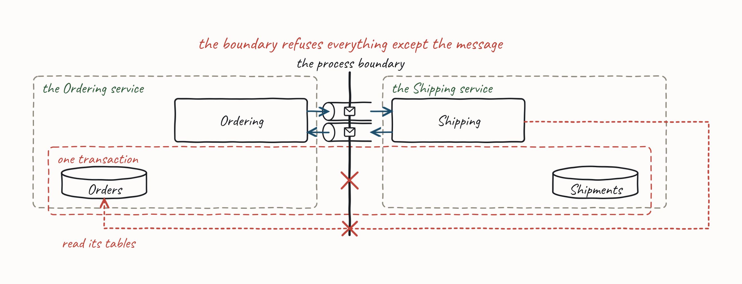
THE PROCESS BOUNDARY
Messages In, Private Data, No Shared Transaction
No transaction spans two services. Consistency stops being something you declare and becomes something you design.
4
Notes:
This is the load-bearing slide of both days, and it is the first one. Everything the course teaches — outbox, sagas, idempotence, choreography, compensation — exists because the third bullet is true. Say that explicitly: it gives delegates a spine to hang the rest on. Keep it to five minutes; it is a premise, not an argument, and the room does not need persuading that processes have boundaries. Do not argue for microservices — the boundary is the subject, and whether you got it from services, from a modular monolith with a queue between two components, or from talking to another company is not this course's business. §Coupling picks it up immediately: the boundary has already taken the two tightest coupling modes off the table, and What's Left Is in the Message is the bill for the rest.

Slide 5
THE PROCESS BOUNDARY
Robust — Guaranteed Delivery
The boundary costs you transactions. It buys you this — and this one is cheap.
We want the work not to be lost when something we depend on is slow, overwhelmed, or down.
•
Store and forward. The work waits somewhere durable until whoever does it is ready. The outage becomes a delay.
•
You do not need to reorganise anything to get this. A single team with a single web application can have it on Monday.
•
One team, one service, one queue. Robustness without reorganising the company.
5
Notes:
§4.4 Guaranteed Delivery is the spine of the afternoon, and this slide is the inoculation — it exists so nobody in the room can file the course under "not for us, we're a monolith". Say the callout and move on; the mechanism is two hours away and they will recognise it when it arrives. Do not say "the second property" — the two-properties framing now lives on Day 2, and this slide has to stand alone.

Slide 6
PRACTICAL MESSAGING — DAY ONE
Coupling
What the process boundary bought you, and what you can still give back.
6

Slide 7
COUPLING
What the Process Boundary Already Bought You
The classic coupling scale runs Content → Common → Control → Stamp → Data, tightest first. Drawing a process boundary takes the top two off the table.
Content — one party reaches into the other's internals. Across a network this can only survive as a degenerate form: depending on undocumented behaviour, a private endpoint, someone else's table. There is no pointer into another process's memory.
•
Common — both parties share the same mutable store. Uncontrolled propagation of change; nobody owns the schema. Separate processes with private data do not have one.
•
This is what Messages In, Private Data, No Shared Transaction buys you: the two tightest forms of coupling are not available across a process boundary.
7
Notes:
This slide opens the section cold, so give it one sentence of framing before the scale: coupling decides whether we can deploy independently, and how far a change spreads — it is a delivery and availability concern, not code tidiness. Then the good news: this is the first thing delegates get back from drawing a boundary. Say plainly that content coupling barely translates across a network boundary rather than pretending the scale ports over unchanged; the honest version is more persuasive. The scale is Myers' structured-design scale, adapted to services — say so.

Slide 8
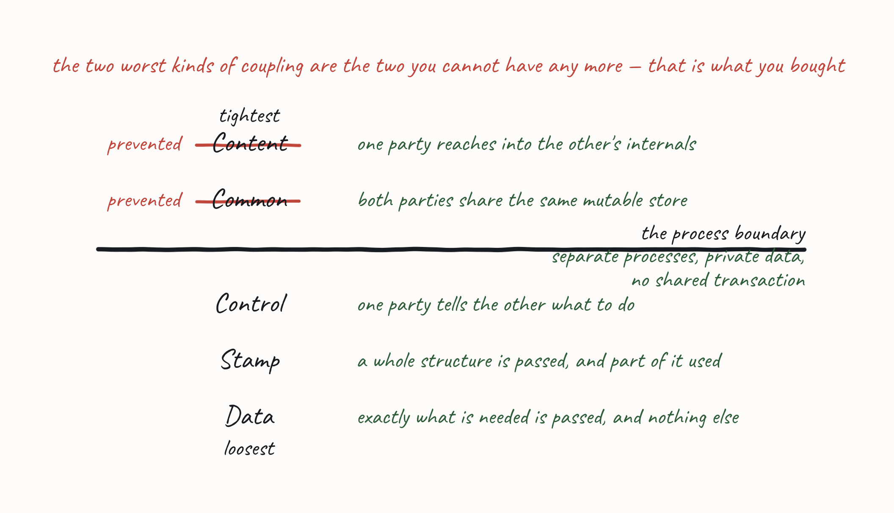
COUPLING
What the Process Boundary Already Bought You
8
Notes:
This slide opens the section cold, so give it one sentence of framing before the scale: coupling decides whether we can deploy independently, and how far a change spreads — it is a delivery and availability concern, not code tidiness. Then the good news: this is the first thing delegates get back from drawing a boundary. Say plainly that content coupling barely translates across a network boundary rather than pretending the scale ports over unchanged; the honest version is more persuasive. The scale is Myers' structured-design scale, adapted to services — say so.

Slide 9
COUPLING
What's Left Is in the Message
You cannot avoid the other three. Every message you send picks one, whether or not you meant to.
Control — you tell the other party what to do rather than what happened. A what-to-do flag in the payload. The receiver's behaviour is now your business.
•
Stamp — you share a composite structure and each of you uses only part of it. A change to a field you never read can still break you.
•
Data — you share only the elementary values you each actually need.
•
Stamp coupling is the one you will meet every day.
The boundary chose the first two for you. The message is where you choose the third.
9
Notes:
This is the slide the rest of the course keeps coming back to. Stamp coupling recurs everywhere: it is the argument for skinny messages (§6.1 Fat and Skinny, at the end of today) and for tolerant readers (the Managing Asynchronous APIs handout). Flag it now so both call-backs land. The second callout is the one to write on the board — it is why §6 Designing Messages exists at all, and it is why Messaging wins the comparison when §Integration Styles closes on Why Messaging.

Slide 10
COUPLING
Must We Both Be Up?
The second axis is time. If both parties must be present for the communication to succeed, they are temporally coupled: the availability of one becomes the availability of the other.
 | Synchronous conversation | Asynchronous conversation
Shape | Request → Reply | Store and forward
Both present? | Yes | No — pick it up later
Analogy | A phone call | Snail mail
Temporal coupling | Introduces it | Avoids it
It is the axis that multiplies your outages. Call a service and wait, and your availabilities multiply: four services at 99.9% leaves you at 99.6%, before anything has actually failed.
•
Send a message and don't wait, and they don't. Guaranteed delivery means the message outlives their outage and is processed when they come back.
•
If my availability depends on yours, I have bought your outages.
10
Notes:
Do the arithmetic on the board — 0.999⁴ = 0.996 — then be honest about the trade: the messaging version does not make the downstream outage vanish, it buys an availability loss back as latency variance. That is usually a trade you can accept, and it is the argument the whole course rests on. Redundancy within a service raises availability; chaining temporally-coupled calls throws the gain away. This is where robust stops being a slogan and gets a number, and breaking this axis is what guaranteed delivery buys you. Note the asymmetry with the previous slide: the "about" axis you choose per message; this one you choose per style of integration, which is the next section.

Slide 11
COUPLING
Two Axes, Not One Scale
"Loose coupling" is not a single dial. What we are coupled about and whether we must both be up move independently:
gRPC with a flat DTO — data coupled, but temporally coupled.
•
A command message with a what-to-do flag — control coupled, but temporally decoupled.
•
A shared database — common coupled, and temporally decoupled.
•
An event carrying a whole entity — stamp coupled, temporally decoupled.
•
11
Notes:
This is the slide the next section pays off — Integration Styles plots File Transfer, Shared Database, RPC and Messaging onto exactly this grid. It also explains why RPC's verdict needs two words ("control and temporal") where the others need one. Note that the shared-database example sits in the prevented half of the previous slide: you can only get there by choosing to, which is the point the next section makes about it.

Slide 12
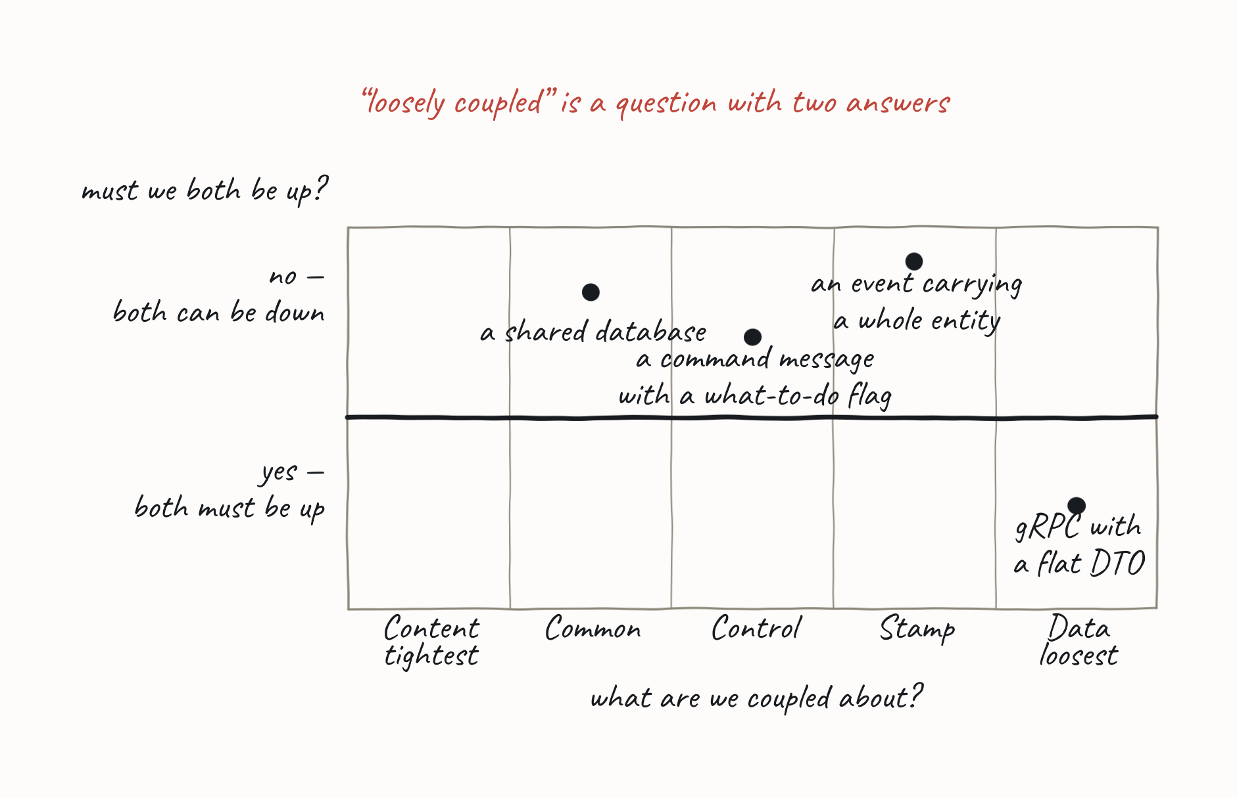
COUPLING
Two Axes, Not One Scale
12
Notes:
This is the slide the next section pays off — Integration Styles plots File Transfer, Shared Database, RPC and Messaging onto exactly this grid. It also explains why RPC's verdict needs two words ("control and temporal") where the others need one. Note that the shared-database example sits in the prevented half of the previous slide: you can only get there by choosing to, which is the point the next section makes about it.

Slide 13
PRACTICAL MESSAGING — DAY ONE
Integration Styles
Four ways to communicate between processes — and what each one gives back.
13

Slide 14
INTEGRATION STYLES
File Transfer
One application writes a file; another reads it later. The file is the contract.
Asynchronous conversation — nobody has to be up at the same time.
•
Data coupling — if you keep the file format elementary.
•
And the file is a message. A batch of them, in a channel that happens to be a filesystem.
14
Notes:
Plant this, and collect it on Why Messaging. File Transfer and Messaging land in the same cell of the grid — asynchronous, and data coupled if the format stays elementary — so coupling alone will not separate them. What the file does not give you is ordering, locking and competing consumers, delivery guarantees, and any granularity finer than a batch. Do not list those here; the room should meet the gap when the grid makes it a question.

Slide 15
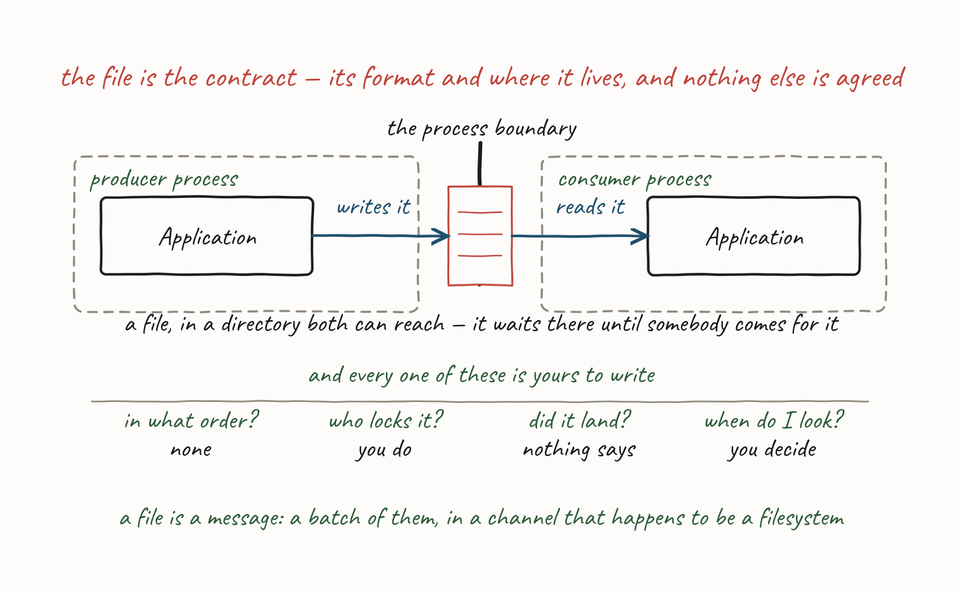
INTEGRATION STYLES
File Transfer
15
Notes:
Plant this, and collect it on Why Messaging. File Transfer and Messaging land in the same cell of the grid — asynchronous, and data coupled if the format stays elementary — so coupling alone will not separate them. What the file does not give you is ordering, locking and competing consumers, delivery guarantees, and any granularity finer than a batch. Do not list those here; the room should meet the gap when the grid makes it a question.

Slide 16
INTEGRATION STYLES
Shared Database
Both applications read and write the same schema, typically through an ORM.
Asynchronous conversation — the writer and the reader need never be present at the same time.
•
Common coupling — and that is the problem.
•
Nobody owns the schema. A change propagates to every reader whether they wanted it or not, and you are back to agreeing release dates across teams — which is exactly what the boundary was for.
16
Notes:
The sharpest verdict in the section. Be blunt: a shared database is not a shortcut past the boundary, it is a decision to un-draw it. Note it is not temporally coupled — its problem is the shared mutable schema, not availability. That is exactly why one axis was never enough.

Slide 17
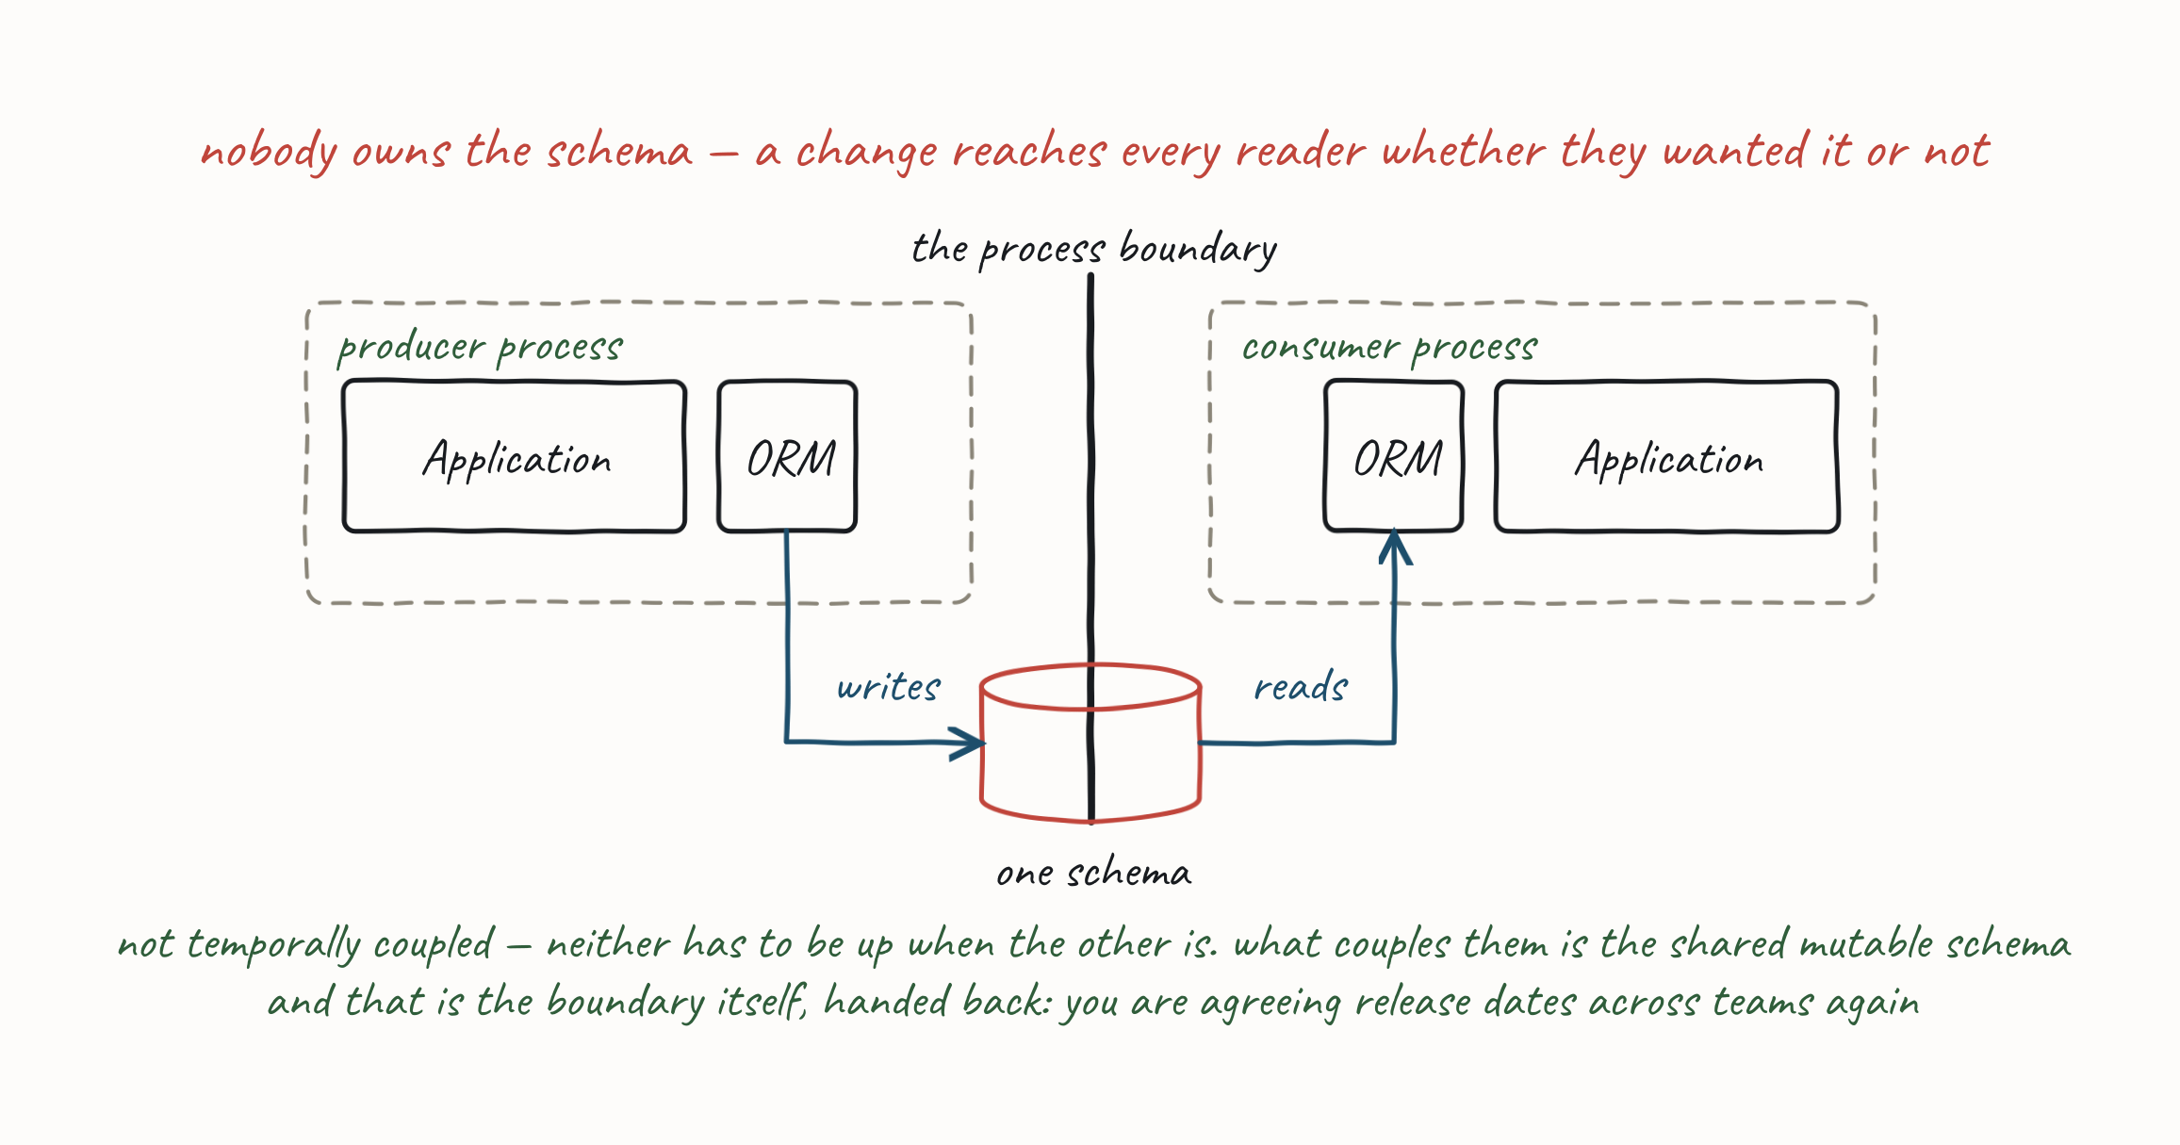
INTEGRATION STYLES
Shared Database
This is the one style that hands back what the boundary bought you.
17
Notes:
The sharpest verdict in the section. Be blunt: a shared database is not a shortcut past the boundary, it is a decision to un-draw it. Note it is not temporally coupled — its problem is the shared mutable schema, not availability. That is exactly why one axis was never enough.

Slide 18
INTEGRATION STYLES
Remote Procedure Call
One application invokes an operation on another and waits for the result.
Synchronous conversation — both parties must be up.
•
Control coupling and temporal coupling.
•
18
Notes:
You are telling the other party what to do — control coupling — and waiting while it does it, which is where §Coupling's arithmetic bites: 0.999⁴ = 0.996. Be fair to it: RPC is the right answer when you genuinely need the reply before you can continue, and Day 1 §5 Conversations has a whole slide on Blocking In-Out. It is the default that is wrong, not the pattern.

Slide 19
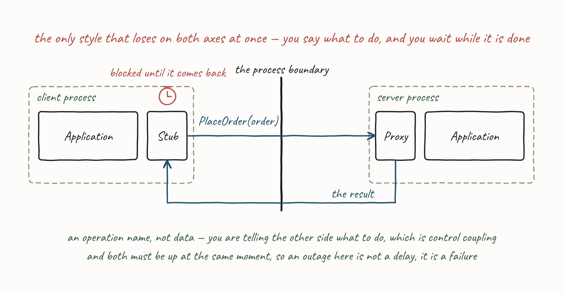
INTEGRATION STYLES
Remote Procedure Call
19
Notes:
You are telling the other party what to do — control coupling — and waiting while it does it, which is where §Coupling's arithmetic bites: 0.999⁴ = 0.996. Be fair to it: RPC is the right answer when you genuinely need the reply before you can continue, and Day 1 §5 Conversations has a whole slide on Blocking In-Out. It is the default that is wrong, not the pattern.

Slide 20
INTEGRATION STYLES
Messaging
One application writes a message to a channel; another consumes it.
Asynchronous conversation — store and forward; the outage becomes a delay.
•
Coupled about… whatever you put in the message. A command is control coupled. A whole-entity event is stamp coupled. A message carrying only what the receiver needs is data coupled.
•
20
Notes:
The verdict cell used to read "data coupling", which was wrong and contradicted §Coupling's own examples — that section plots a command message as control coupled and a whole-entity event as stamp coupled. Fixing it is what makes the argument: the other three styles fix your position on the "about" axis; messaging leaves it open. That is not a hedge, it is the reason the rest of the course exists — §5 Conversations is the temporal decision and §6 Designing Messages is the "about" decision, and you only get to make either one here.

Slide 21
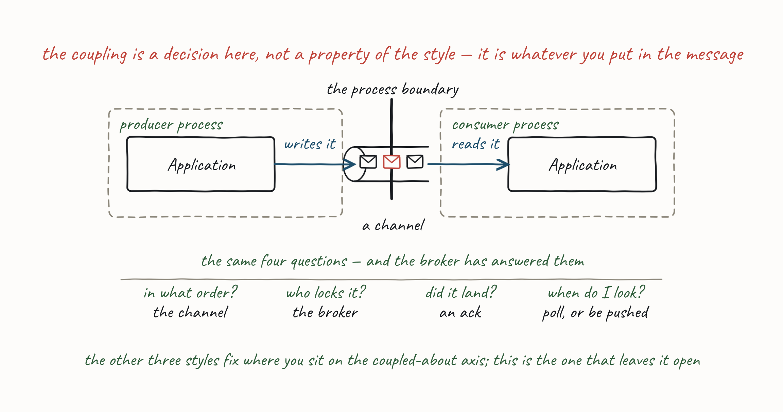
INTEGRATION STYLES
Messaging
Messaging is the only style where the coupling is a decision, not a property of the style.
21
Notes:
The verdict cell used to read "data coupling", which was wrong and contradicted §Coupling's own examples — that section plots a command message as control coupled and a whole-entity event as stamp coupled. Fixing it is what makes the argument: the other three styles fix your position on the "about" axis; messaging leaves it open. That is not a hedge, it is the reason the rest of the course exists — §5 Conversations is the temporal decision and §6 Designing Messages is the "about" decision, and you only get to make either one here.

Slide 22
INTEGRATION STYLES
Why Messaging
The four styles on the grid from §Coupling:
Style | Coupled about | Must we both be up? | What it hands back
File Transfer | Data | No | Nothing — but you get nothing either
Shared Database | Common | No | The boundary itself
Remote Procedure Call | Control | Yes | Independent availability
Messaging | Your choice | No | Nothing
File Transfer and Messaging land in the same cell. Coupling does not separate them — so what does?
Ordering — a directory has none. You write it yourself, or you get whatever the filesystem lists.
•
Locking and competing consumers — two readers on one directory will fight. A broker makes that a configuration option.
•
Delivery guarantees — did the reader finish? Did it crash halfway? Nothing in the file says.
•
Granularity and timeliness — a file is a batch, and a batch arrives when the batch is ready.
•
22
Notes:
This is the section's goal slide: it has to end on why messaging. Do not leave the question — "if File Transfer and Messaging are equally loosely coupled, why build the whole course on messaging?" — hanging for later. Answer it here: file transfer is just messaging, without the support for locks, ordering and the rest; everything the broker does for you is something you would otherwise write. And the last callout is the whole argument of the day in one line. Do not name Reactive — Day 2 needs it fresh.

Slide 23
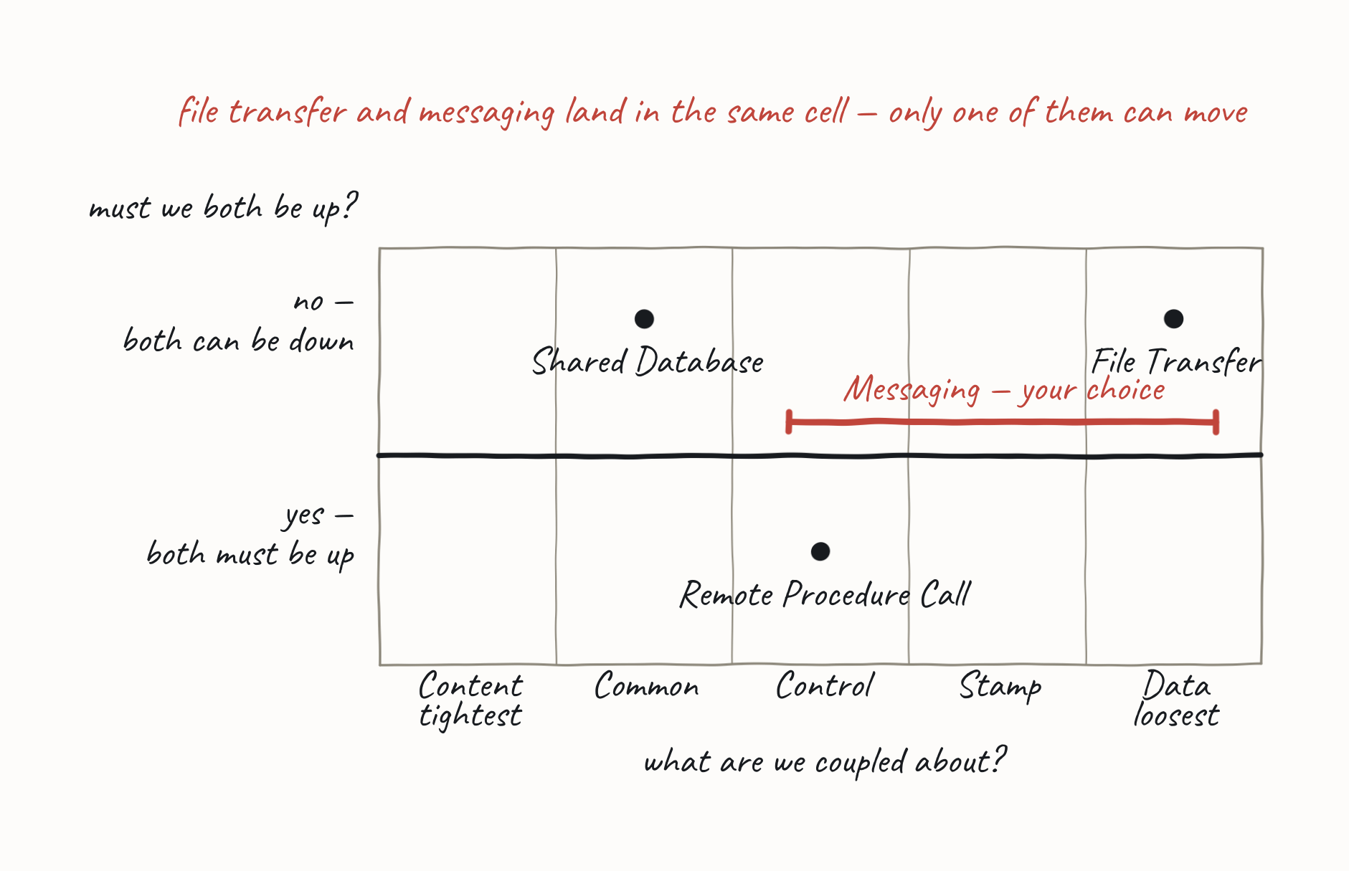
INTEGRATION STYLES
Why Messaging
File transfer is messaging with everything useful left as an exercise.
Only one style keeps everything the process boundary bought you, and lets you choose the rest.
23
Notes:
This is the section's goal slide: it has to end on why messaging. Do not leave the question — "if File Transfer and Messaging are equally loosely coupled, why build the whole course on messaging?" — hanging for later. Answer it here: file transfer is just messaging, without the support for locks, ordering and the rest; everything the broker does for you is something you would otherwise write. And the last callout is the whole argument of the day in one line. Do not name Reactive — Day 2 needs it fresh.

Slide 24
PRACTICAL MESSAGING — DAY ONE
Messaging Patterns
24

Slide 25
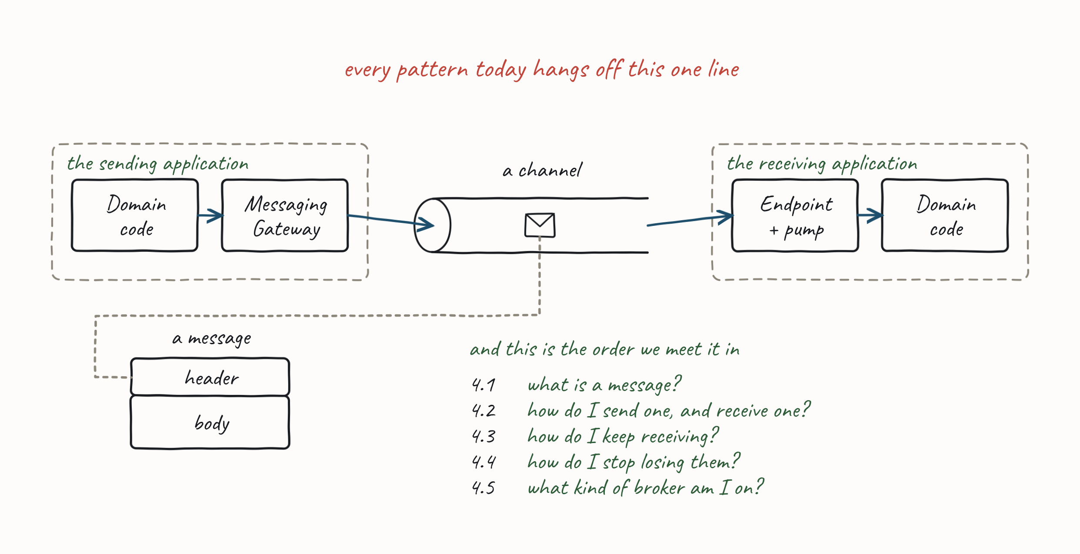
MESSAGING PATTERNS
The Big Picture
A map of the messaging patterns we will cover across the day.
25

Slide 26
PRACTICAL MESSAGING — DAY ONE
4.1 What Is a Message?
Header and body, intent or fact — and whether the channel holds tasks or facts.
26

Slide 27
4.1 WHAT IS A MESSAGE?
Message Construction
A message has a header and a body.
The body contains data for the consumer.
•
The header contains metadata for any filter in the pipeline, and should indicate the format of the body.
•
Break a large message into pieces as a Message Sequence, or use a Claim Check.
•
27
Notes:
Two processes communicating copy data — usually a byte stream — that we break into discrete units so we can tell where a message begins and ends (needed for competing consumers and pub-sub). A message = header (how to process) + body (content). Related concepts: Request-Reply (RPC over messaging, using Return Address + Correlation Identifier); Message Sequence (sequence id, position id, size/end indicator); Message Expiry / Dead Letter for slow messages; Canonical Data Format; and Format Indicator strategies — Version Number, Foreign Key, or embedded Format Document.

Slide 28
4.1 WHAT IS A MESSAGE?
Messaging vs. Eventing (Intent vs. Facts)
Two words the industry uses interchangeably, and they are not the same thing. After Clemens Vasters, two poles of message types.
 | Messaging | Eventing
carries | intent | facts
which looks like | a Command (transfer of control), a Query (request an answer), a transfer of value | a notification — something you report on
expectations | part of a workflow, part of a conversation | none
concerned with | the future | the past — history, context
A message asks for something. An event announces something.
28
Notes:
This is the first fork in every design decision that follows, and §Conversations turns it into a choice of exchange pattern — intent gives you In-Only and In-Out, a fact gives you Out-Only. If you are expressing intent you are addressing someone: you know who should act, and that is behavioural coupling. If you are reporting a fact you are addressing nobody, the subscriber list is not your concern, and that is the loosest coupling available.

Slide 29
4.1 WHAT IS A MESSAGE?
Discrete vs. Series (Eventing Types)
After Clemens Vasters again, a second axis — and this one is about events only.
 | Discrete | Series
handler | stateless | stateful partition processor
delivery | PUSH | PULL
position | independent | context, offset
shape | one thing, immediately actionable | continuous, sequential
what it says | something happened | a condition holds
part of | a conversation | a monolog
29
Notes:
The row that pays off later is position. A discrete event stands alone, so anyone can handle it and order does not matter; a series event only means anything in sequence, which is why the stream in Streams Contain Facts keeps an offset, and why partitioning by key is the only way to scale one. Point back at this table when you draw the partition in §4.3.

Slide 30
4.1 WHAT IS A MESSAGE?
Command / Document / Event Messages
After Gregor Hohpe. Three core message types: Command, Document, Event.
Command Message — reliably invoke a procedure in another application. Encapsulates a request as an object (GoF Command); usually sent Point-to-Point (one consumer).
•
Document Message — reliably transfer a data structure between applications; the receiver decides what, if anything, to do with the data.
•
Event Message — reliable, asynchronous event notification. The difference from a Document Message is timing and content — an event's contents are typically less important.
•
30
Notes:
RPC's advantage is synchrony (immediate, caller blocks) — but that's also its weakness: if the network is down or the remote process isn't listening, the call fails. Asynchronous command messages keep trying until the procedure is invoked. The command's state (parameters) is stored in the message.

Slide 31
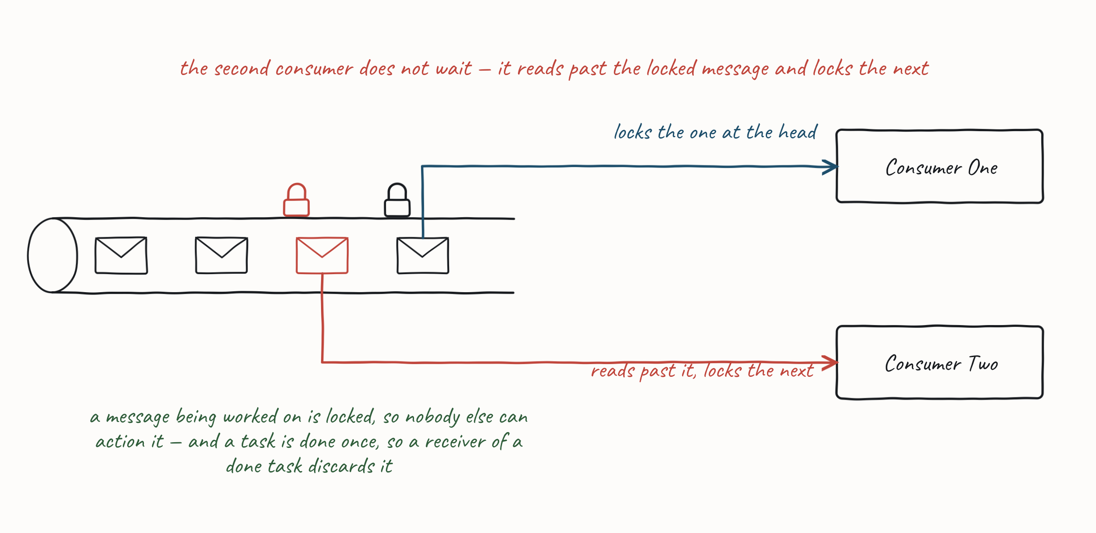
4.1 WHAT IS A MESSAGE?
Queues Contain Tasks
A channel carries one of two things, and which one it is changes almost everything that follows. Messages on a queue are tasks — requests to carry out an action. Once the action is done, the task is gone.
The first consumer locks the next message while it processes it.
•
A second consumer reads past any locked message and locks the next available one.
•
Nobody else should action a done task; a receiver of one discards it. If we cannot action it, someone else must.
•
31
Notes:
The lock is the whole of a queue, and everything in §4.3 and §4.4 rests on it — competing consumers, requeue with delay, dead-lettering, the retry count. Say it here so it is not a surprise later: a queue can hold a message back and hand it to someone else, and a stream cannot.

Slide 32
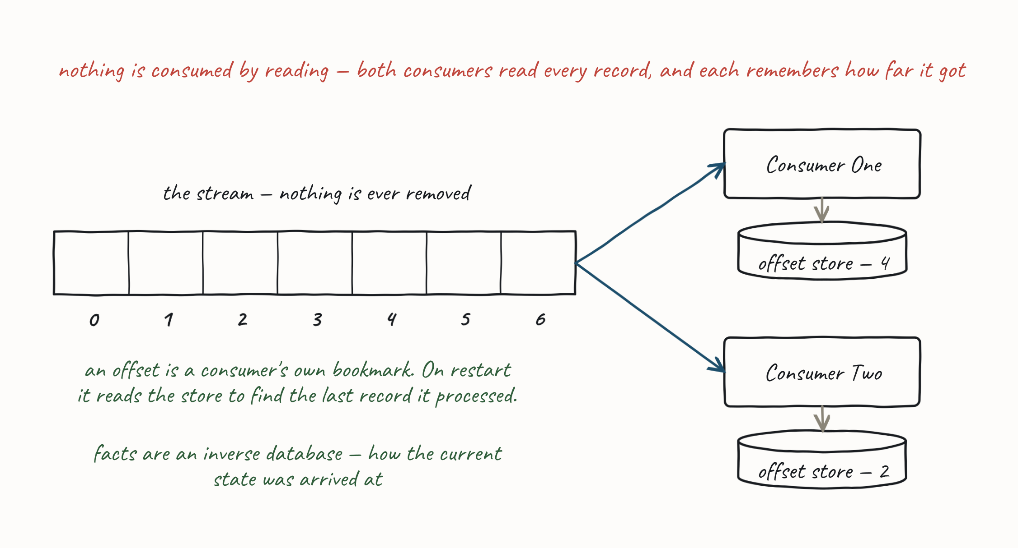
4.1 WHAT IS A MESSAGE?
Streams Contain Facts
Records on a stream are facts — records that a state change occurred. Nothing is consumed by reading and nothing is deleted.
The first consumer reads the next record and processes it; a second consumer reads the next and processes it — and both can read the same records.
•
32
Notes:
The drawing carries the offset story — walk it, do not read it. The offset store under each consumer, the bookmark on restart, and facts as an inverse database are all lettered onto the picture. The one thing that is not on it: navigate the offsets and you can compute a point-in-time position, which is the property that makes a stream a source of truth rather than a transport. This is the series row of the previous table with a picture on it — stateful, PULL, context and offset. There is no lock here and there is nothing to ack, which is why the whole of §4.4 has to be taught twice: once for a broker that can hold a message back, once for one that cannot.

Slide 33
PRACTICAL MESSAGING — DAY ONE
4.2 Sending and Receiving
How do I send a message, and how do I receive one?
33

Slide 34
4.2 SENDING AND RECEIVING
Channels
A channel is a virtual pipe that connects producer and consumer.
A logical address (topic or routing key).
•
Messaging is a "pipe", not a "bucket".
•
Unidirectional. Two-way traffic is two channels, and the sender names the reply channel.
•
One-to-One or One-to-Many.
•
34
Notes:
A channel is a logical view, not physical — the virtual pipe down which messages flow, addressed by a topic or routing key. Middleware may implement channels differently (in-memory, on sender/receiver, or a distributed DB) but that's hidden from producer/consumer. Channels are one-way because we do not consume our own messages. Point-to-Point (one-to-one) or Publish-Subscribe (one-to-many). Not a bucket: a receiver knows what it wants and the sender knows what it is sending.

Slide 35
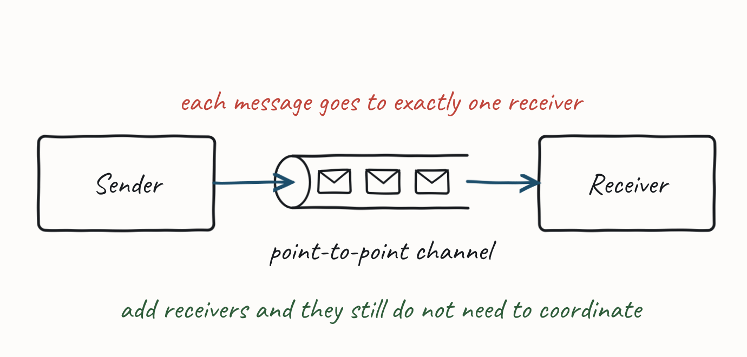
4.2 SENDING AND RECEIVING
Point-to-Point Channel
Only one consumer receives any message. With multiple consumers, the channel ensures only one succeeds, so receivers need not coordinate.
35
Notes:
The channel locks a message until the consumer acks/nacks or times out. On ack it is deleted; while locked, other consumers read past it. This lets us scale out with multiple consumers while only one gets each message. If timed-out messages return to the channel, consumers must tolerate duplicates. (EIP reference.)

Slide 36
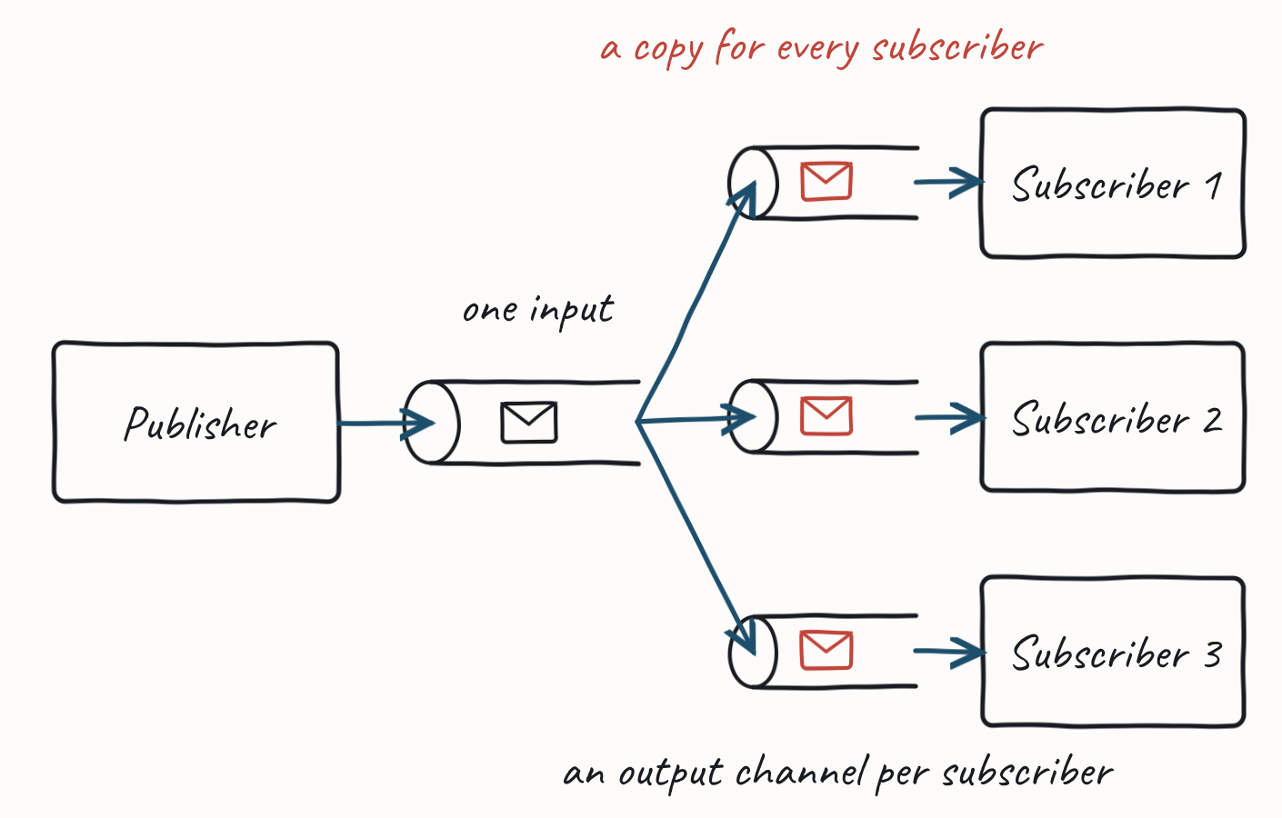
4.2 SENDING AND RECEIVING
Publish-Subscribe Channel
Delivers a copy of each message to every subscriber. A publisher sends to one input channel, replicated onto many output channels, one per subscriber.
36
Notes:
Each output channel behaves like a point-to-point channel — a consumer receives a message once, and with multiple listeners the middleware uses locking + read-past. Pub-sub allows eavesdropping — a firehose of all channels can act like a message store. Both a channel-based and a router-based approach are often shorthanded as "publish-subscribe". (EIP reference.)

Slide 37
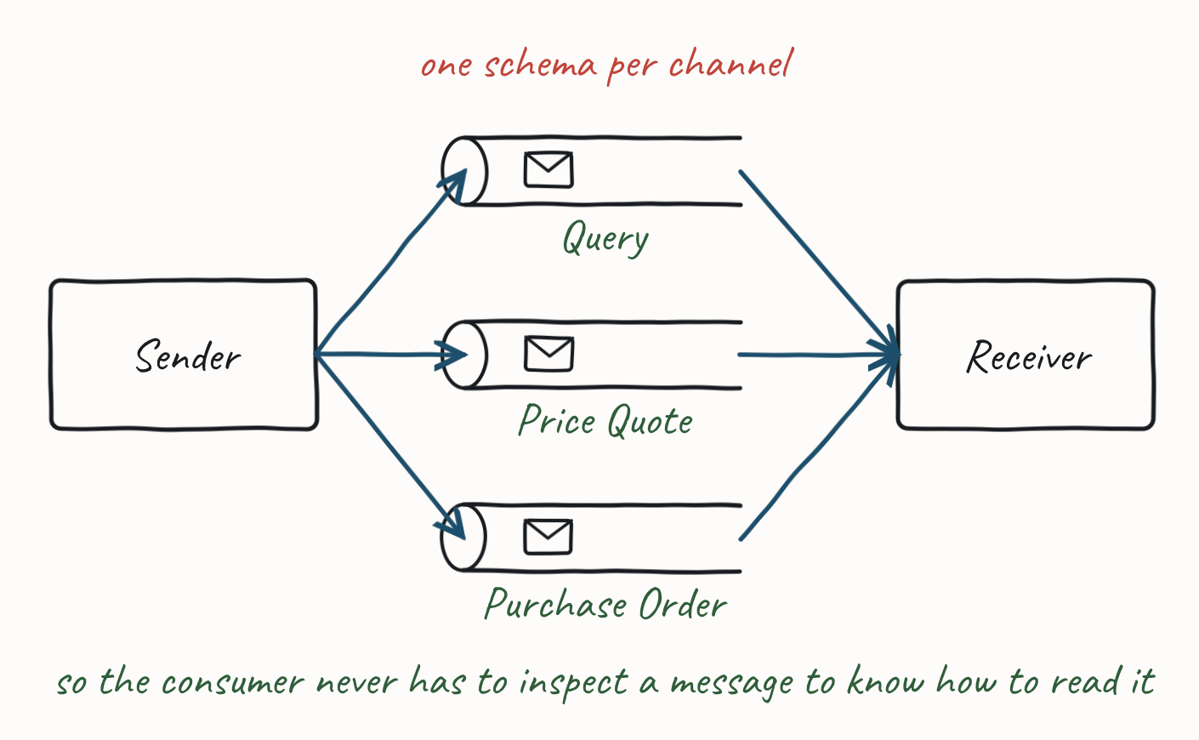
4.2 SENDING AND RECEIVING
Datatype Channel
Use a separate channel per message schema so all messages on a channel share the same schema.
37
Notes:
How does a consumer know how to deserialize a message? Knowing the channel tells it the type. Otherwise the consumer must inspect header/body to determine type and look up how to deserialize — unneeded complexity if a separate channel works. The reason not to use one: messages that must be processed in sequence but have different, non-unifiable schemas. (EIP reference.)

Slide 38
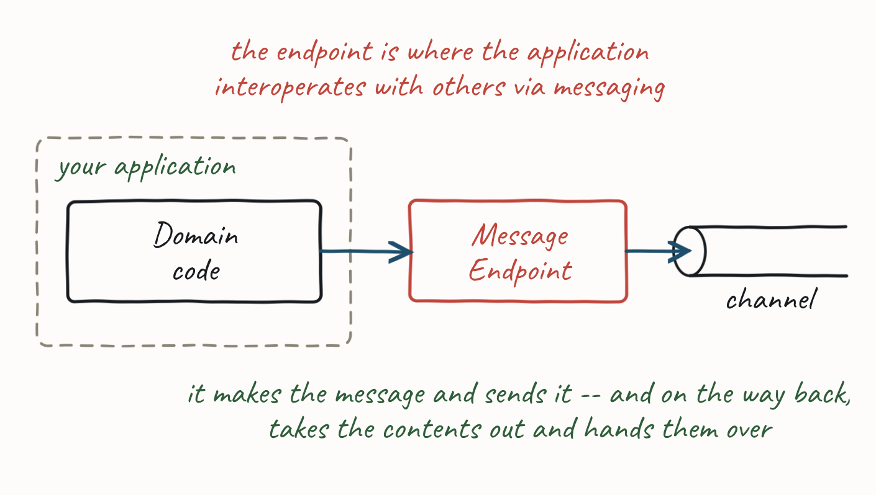
4.2 SENDING AND RECEIVING
Message Endpoint
How does an application connect to a channel to send and receive?
38
Notes:
We want to separate messaging concerns from domain concerns — a developer shouldn't need to know middleware, formats, or channels. Application code just knows it has data to send or expects data. The Message Endpoint takes that data, makes a message, and sends it on a channel; on receipt it extracts contents and gives them to the application meaningfully. Endpoint code is custom to the middleware's client API. (EIP reference.)

Slide 39
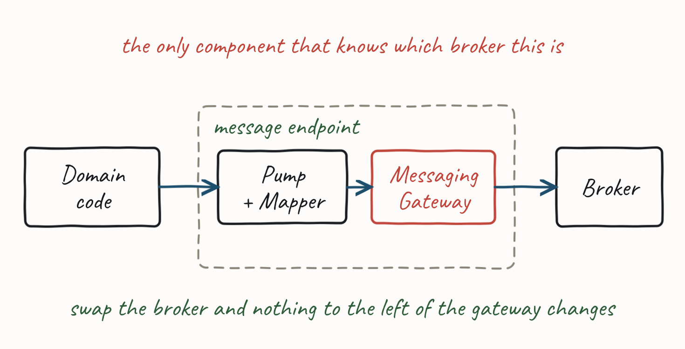
4.2 SENDING AND RECEIVING
Messaging Gateway
Within the endpoint, encapsulate the middleware-access code in a Messaging Gateway, isolating all middleware dependencies into one component so the domain is isolated from messaging concerns.
39
Notes:
Gateway vs. Endpoint: the endpoint contains the gateway but may also run a message pump, map messages to domain types, and call application code — which is what the picture shows. The gateway only abstracts middleware interaction. An endpoint may support multiple middleware offerings, the gateway abstracting each so application code can switch middleware without changing. (EIP reference.)

Slide 40
PRACTICAL MESSAGING — DAY ONE
4.3 The Message Pump
How do I keep receiving — looping on the receiver.
40

Slide 41
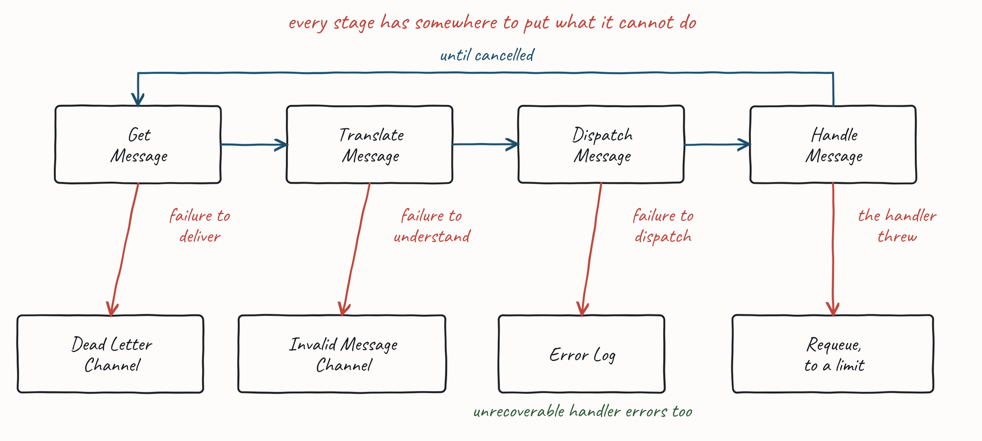
4.3 THE MESSAGE PUMP
The Message Pump
The code that takes a message from a channel and delivers it to application code, running in a loop until cancelled: Get → Translate → Dispatch → Handle.
Each stage fails in its own way. That is why a message which is never going to be handled has four different places to end up.
41
Notes:
The loop takes a message, translates the body into a type the application understands, looks up the handlers registered for that type, and dispatches. Control passes from the endpoint to application code. Walk the four risers on the picture and say what each one costs. A failure to dispatch means the application is misconfigured: log it, do not ack, and shut down, because acking would lose the message and carrying on would lose the next one too. An unrecoverable application error is the opposite — ack to remove it, because replaying it would fail the same way, and log it; processing continues. A transient error is requeued, usually with a delay, up to a limit, and past the limit it is treated as unrecoverable. That limit is the poison-pill guard.

Slide 42
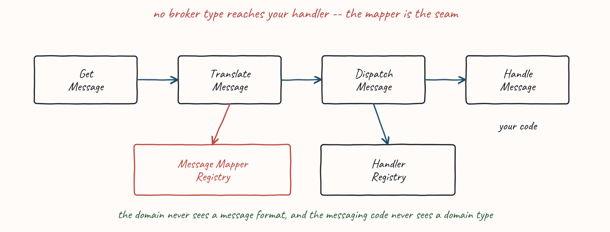
4.3 THE MESSAGE PUMP
Translate and Dispatch
Two of those four stages are driven by a registry: Translate looks up a Message Mapper, Dispatch looks up a handler.
A Message Mapper converts between a message and a domain object.
•
A handler is your code, subscribed to the channels the endpoint listens on.
•
42
Notes:
The endpoint registers mappers per channel, which is what a datatype channel is for. The mapper is the seam the exercises are checked against: if a handler's signature has a broker type in it, the mapper has not finished its job.

Slide 43
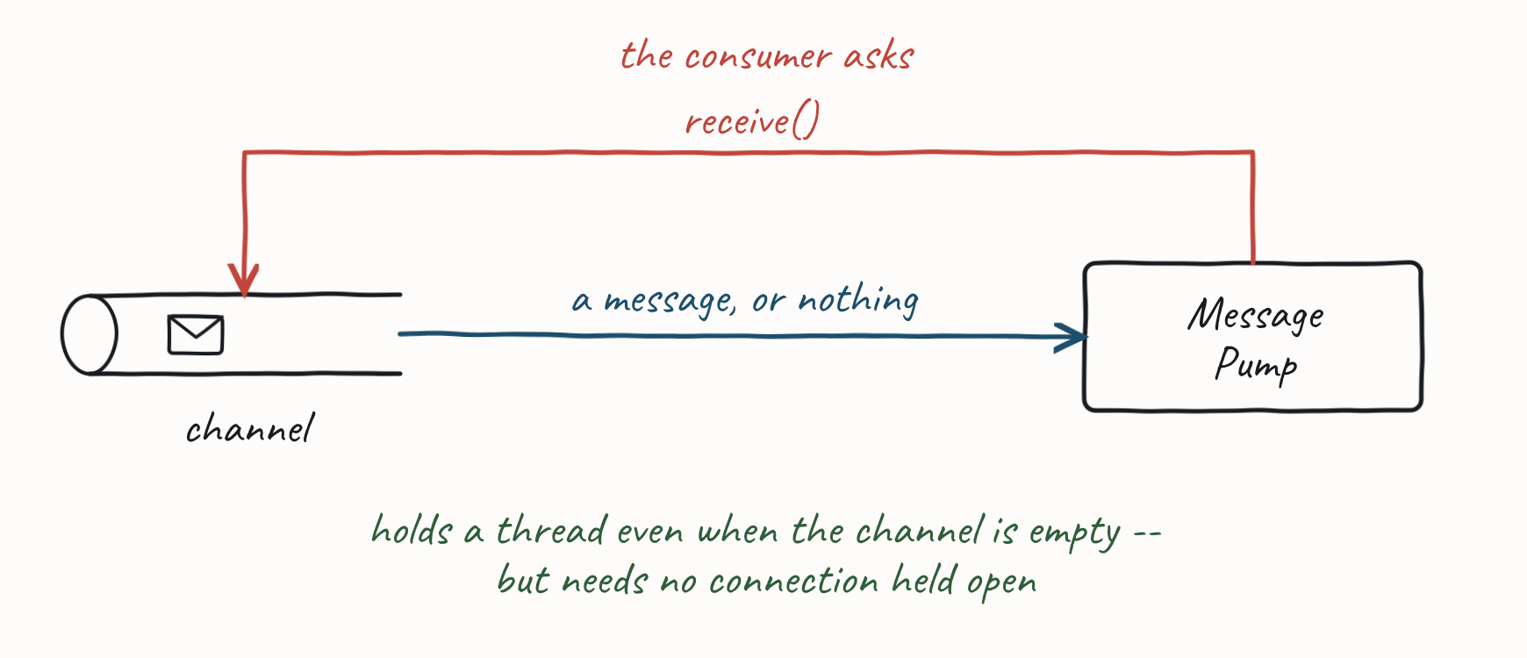
4.3 THE MESSAGE PUMP
Polling Consumer
The message pump makes an explicit call to check for messages. Consumes a thread even when idle, but needs no held-open connection to the middleware. (EIP reference.)
43

Slide 44
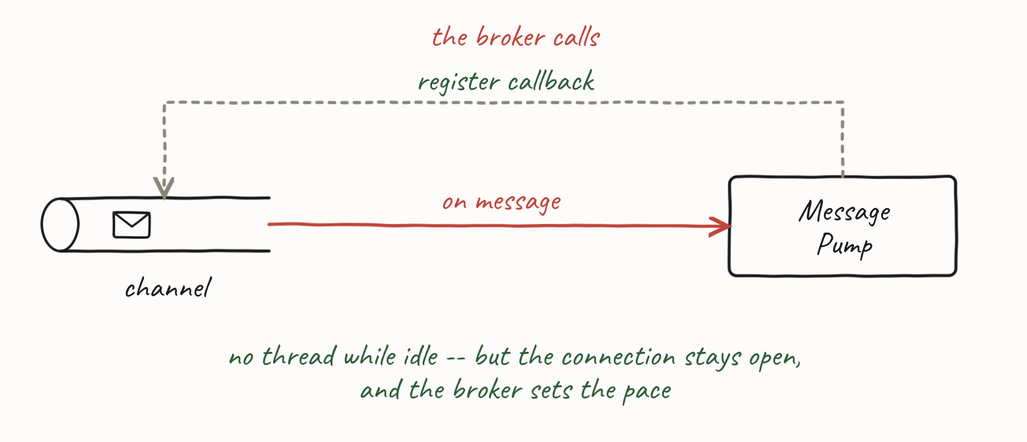
4.3 THE MESSAGE PUMP
Event Driven Consumer
The pump registers a callback that the middleware invokes when a message is available. Doesn't consume a thread, but requires a held-open connection (or the app to serve middleware requests). (EIP reference.)
44

Slide 45
4.3 THE MESSAGE PUMP
Service Activator
The line between the messaging code and your code.
Everything in this sub-topic so far — endpoint, pump, mapper, registries — is the messaging gateway. The handler is your code. The Service Activator is the join, and its whole job is that the handler does not know the pump exists.
The pump has a message; the Message Mapper has already turned it into a domain object.
•
The activator makes an ordinary synchronous, in-process method call into your code, usually through a service layer.
•
The handler takes a domain type and returns, or throws. No channel, no broker, no headers, no ack.
•
Dispatch is hard-coded to one service, or reflective on the message type — which is what the Handler Registry on Translate and Dispatch is for.
•
One-way (request only) or two-way (Request-Reply).
•
Because nothing in the handler is messaging-aware, anything else can call it too — a developer test, an HTTP endpoint, a gRPC service. Useful, and worth calling out; but it is a consequence of the separation, not the reason for it.
•
45
Notes:
The point is the separation, not the testability: the gateway owns everything about messaging, and the handler is independent of it. Being able to invoke application code from callers other than the pump — developer tests, for one — follows from that, and lands better as evidence for the separation than as the headline. The sentence to say out loud is that the gateway handles all messaging details so the service does not know it is invoked via messaging at all.

Slide 46
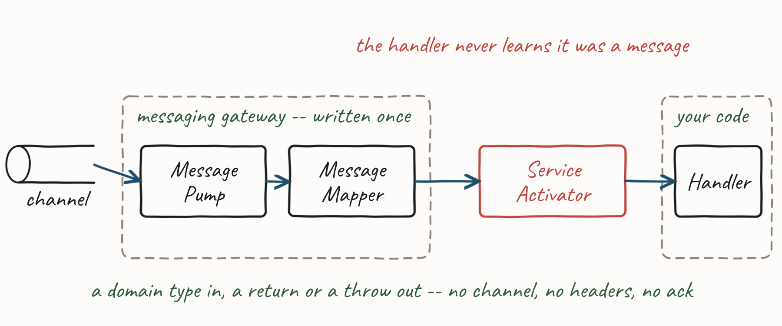
4.3 THE MESSAGE PUMP
Service Activator
Your handler is not a message handler. It is a method that happens to be called by one.
46
Notes:
The point is the separation, not the testability: the gateway owns everything about messaging, and the handler is independent of it. Being able to invoke application code from callers other than the pump — developer tests, for one — follows from that, and lands better as evidence for the separation than as the headline. The sentence to say out loud is that the gateway handles all messaging details so the service does not know it is invoked via messaging at all.

Slide 47
4.3 THE MESSAGE PUMP
Competing Consumers
If the Rate of Arrival of messages (RoA) exceeds the Rate of Consumption (RoC), your channel backs up and the age of any message in it increases. At some point the time a message waits in the channel becomes unacceptable.
You solve this by competing consumers — but the implementation differs between queues and streams, and so does what it costs you.
47
Notes:
Get the arithmetic said out loud: RoC is one over the time to handle a message and ack or nack it, per consumer. If RoA exceeds RoC and it is not a burst, you never catch up — adding consumers is the only lever, because the other two are someone else's code. Ask whether they also have a deadline: a channel that drains eventually can still be useless. Competing Consumers on a Queue and on a Stream are the same answer on the two brokers, and the difference between them is the whole reason §4.1 made you choose one. (EIP reference.)

Slide 48
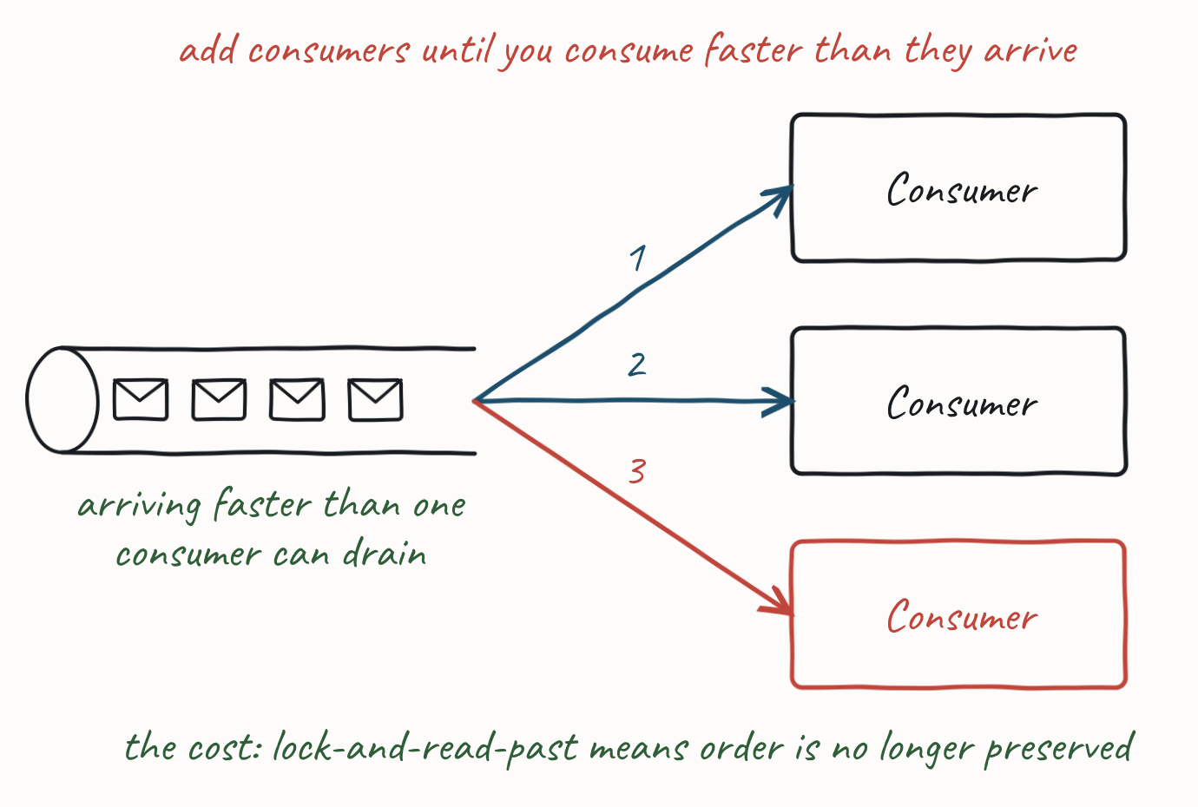
4.3 THE MESSAGE PUMP
Competing Consumers
48
Notes:
Get the arithmetic said out loud: RoC is one over the time to handle a message and ack or nack it, per consumer. If RoA exceeds RoC and it is not a burst, you never catch up — adding consumers is the only lever, because the other two are someone else's code. Ask whether they also have a deadline: a channel that drains eventually can still be useless. Competing Consumers on a Queue and on a Stream are the same answer on the two brokers, and the difference between them is the whole reason §4.1 made you choose one. (EIP reference.)

Slide 49
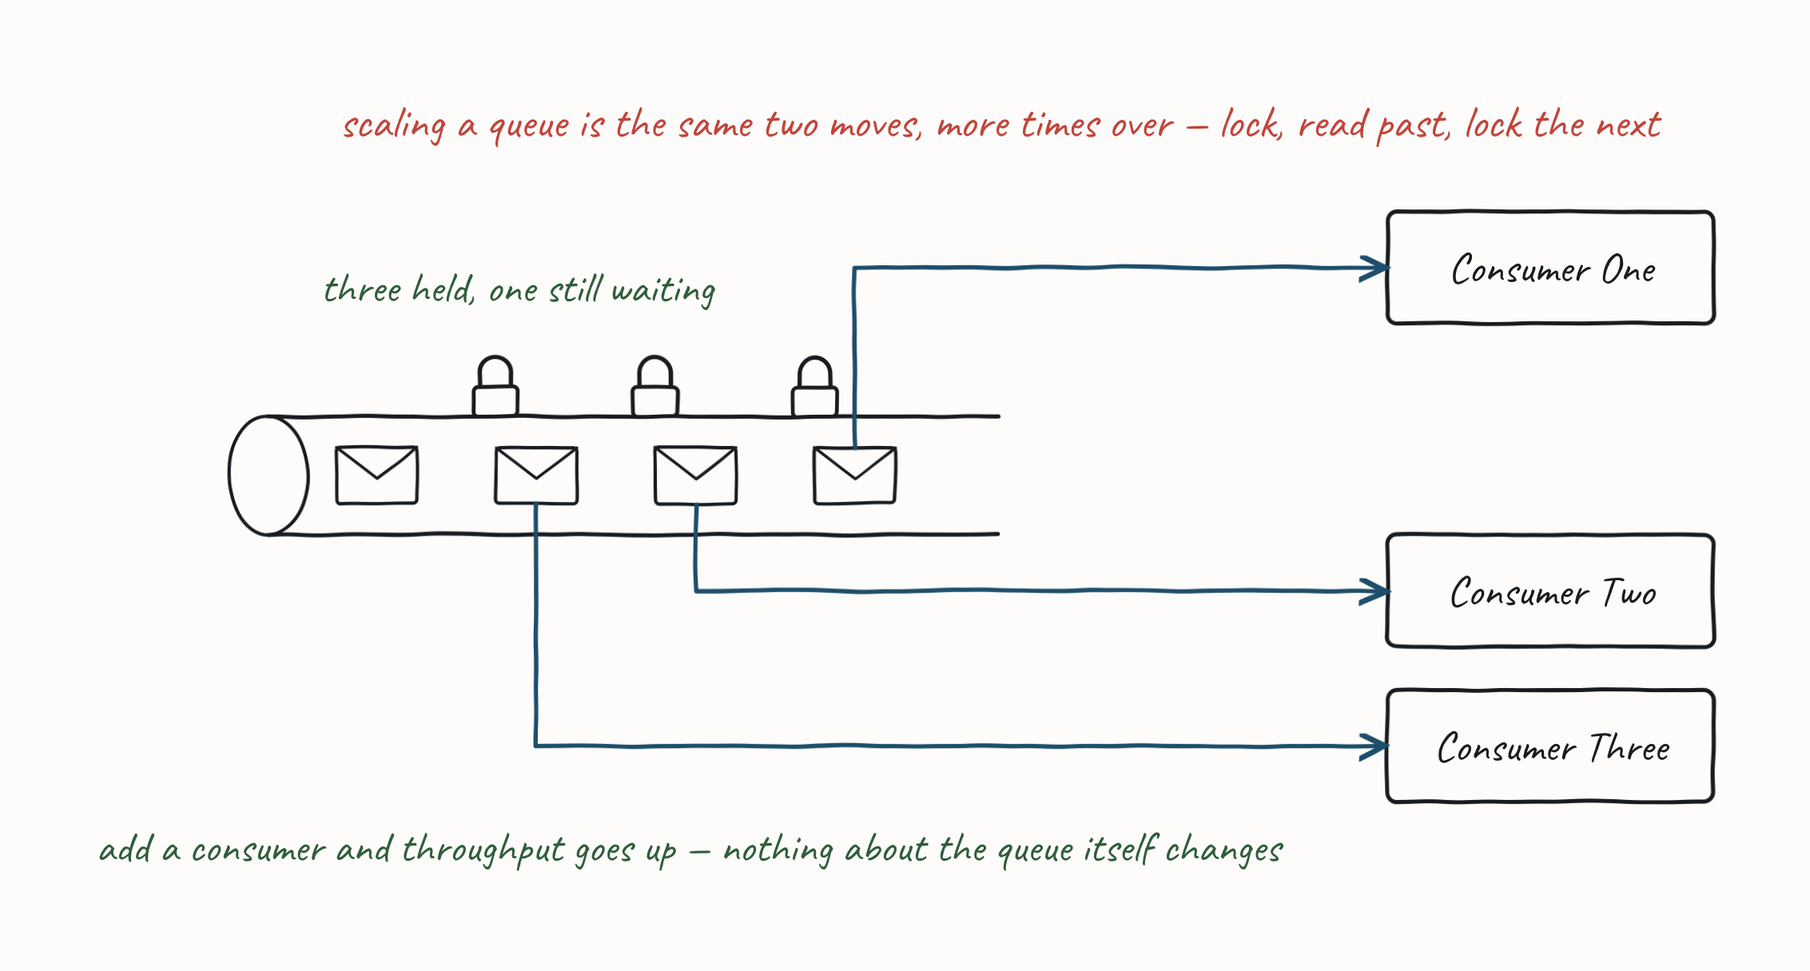
4.3 THE MESSAGE PUMP
Competing Consumers on a Queue
Add consumers to the same queue. The broker's lock does the rest.
A consumer takes the next message and locks it — this item is being processed.
•
Another consumer reads past the locked one and picks up the next item.
•
Nothing says which of them finishes first, so you have sacrificed ordering to get the throughput.
•
49
Notes:
Read-past buys you throughput. It spends your ordering to do it — say that line, it is the one the room should leave with. This is the lock from §4.1 doing the work it exists for. Push on the ordering cost, because rooms consistently under-rate it: two consumers, two messages for the same customer, and nothing in the system decides which lands first. If they need ordering they do not need a bigger queue, they need Competing Consumers on a Stream.

Slide 50
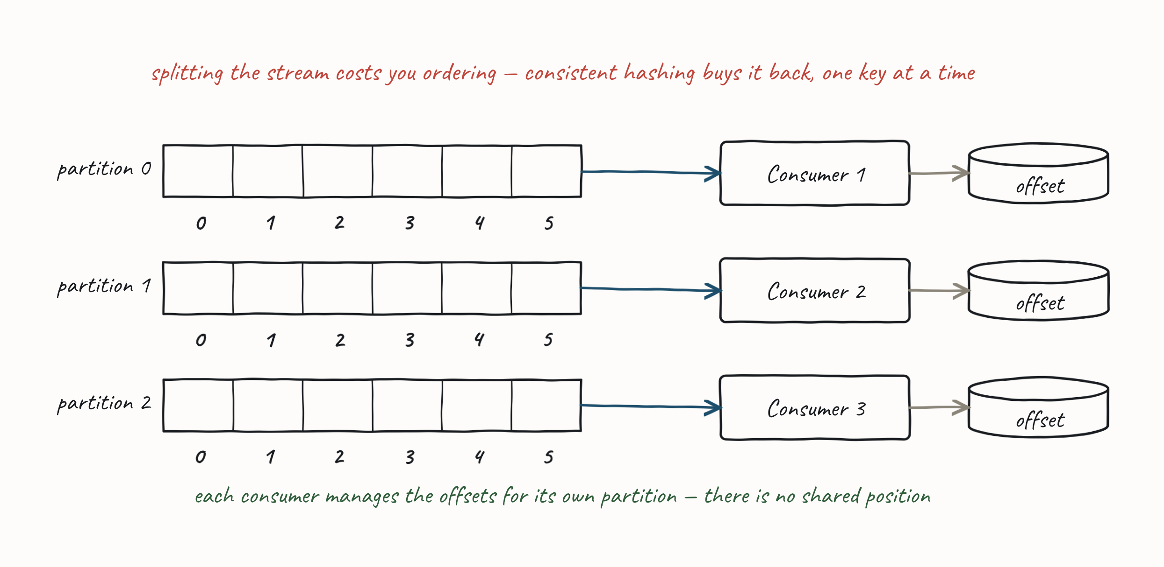
4.3 THE MESSAGE PUMP
Competing Consumers on a Stream
There is no lock, so there is no read-past. You scale by partitioning.
Partition by a key — consistent hashing puts same-key records in the same partition.
•
Each partition has one consumer, and each consumer keeps its own offset.
•
Order holds inside a partition, so you keep ordering for everything that shares a key.
•
The price: no delay and no read-past. A slow record holds up its partition, and there is nothing to skip it with.
•
50
Notes:
On a queue you spend ordering to buy throughput. On a stream you spend the read-past instead — that is the pair of slides in one sentence; say it here, with both pictures still fresh. Choose the key deliberately: it has to be the thing whose order matters — the entity id, not the message type — and it has to spread, or one partition takes all the traffic and you have scaled nothing. Say what happens when a record will not process: on a queue someone else reads past it, on a stream the partition stops. That is the same trade the room will meet again on the error slides in §4.4, and it is why they are taught twice there.

Slide 51
4.3 THE MESSAGE PUMP
Worked Example — the Task Queue
The pump and competing consumers, as an application shape. Offloading work from a request path.
The web server puts the work on a queue and returns immediately.
•
The queue stores the work until we are ready to consume it — we can throttle to prevent surges.
•
A backend application does the long-running or CPU-intensive work, freeing the web server to service new requests.
•
We scale out the backend with competing consumers so the queue does not back up.
•
What it buys: the web server stays responsive when the backend is slow, overwhelmed, or down. The work is not lost — it waits.
51
Notes:
The opener kept the want — Robust — Guaranteed Delivery — and this is the mechanism, which belongs here, where the parts have names. Everything that slide gestured at vaguely in the first ten minutes is now vocabulary the room owns: channel, pump, competing consumers. Call the callback out loud — this is the promise from the first ten minutes, and now they can read how it is kept.

Slide 52
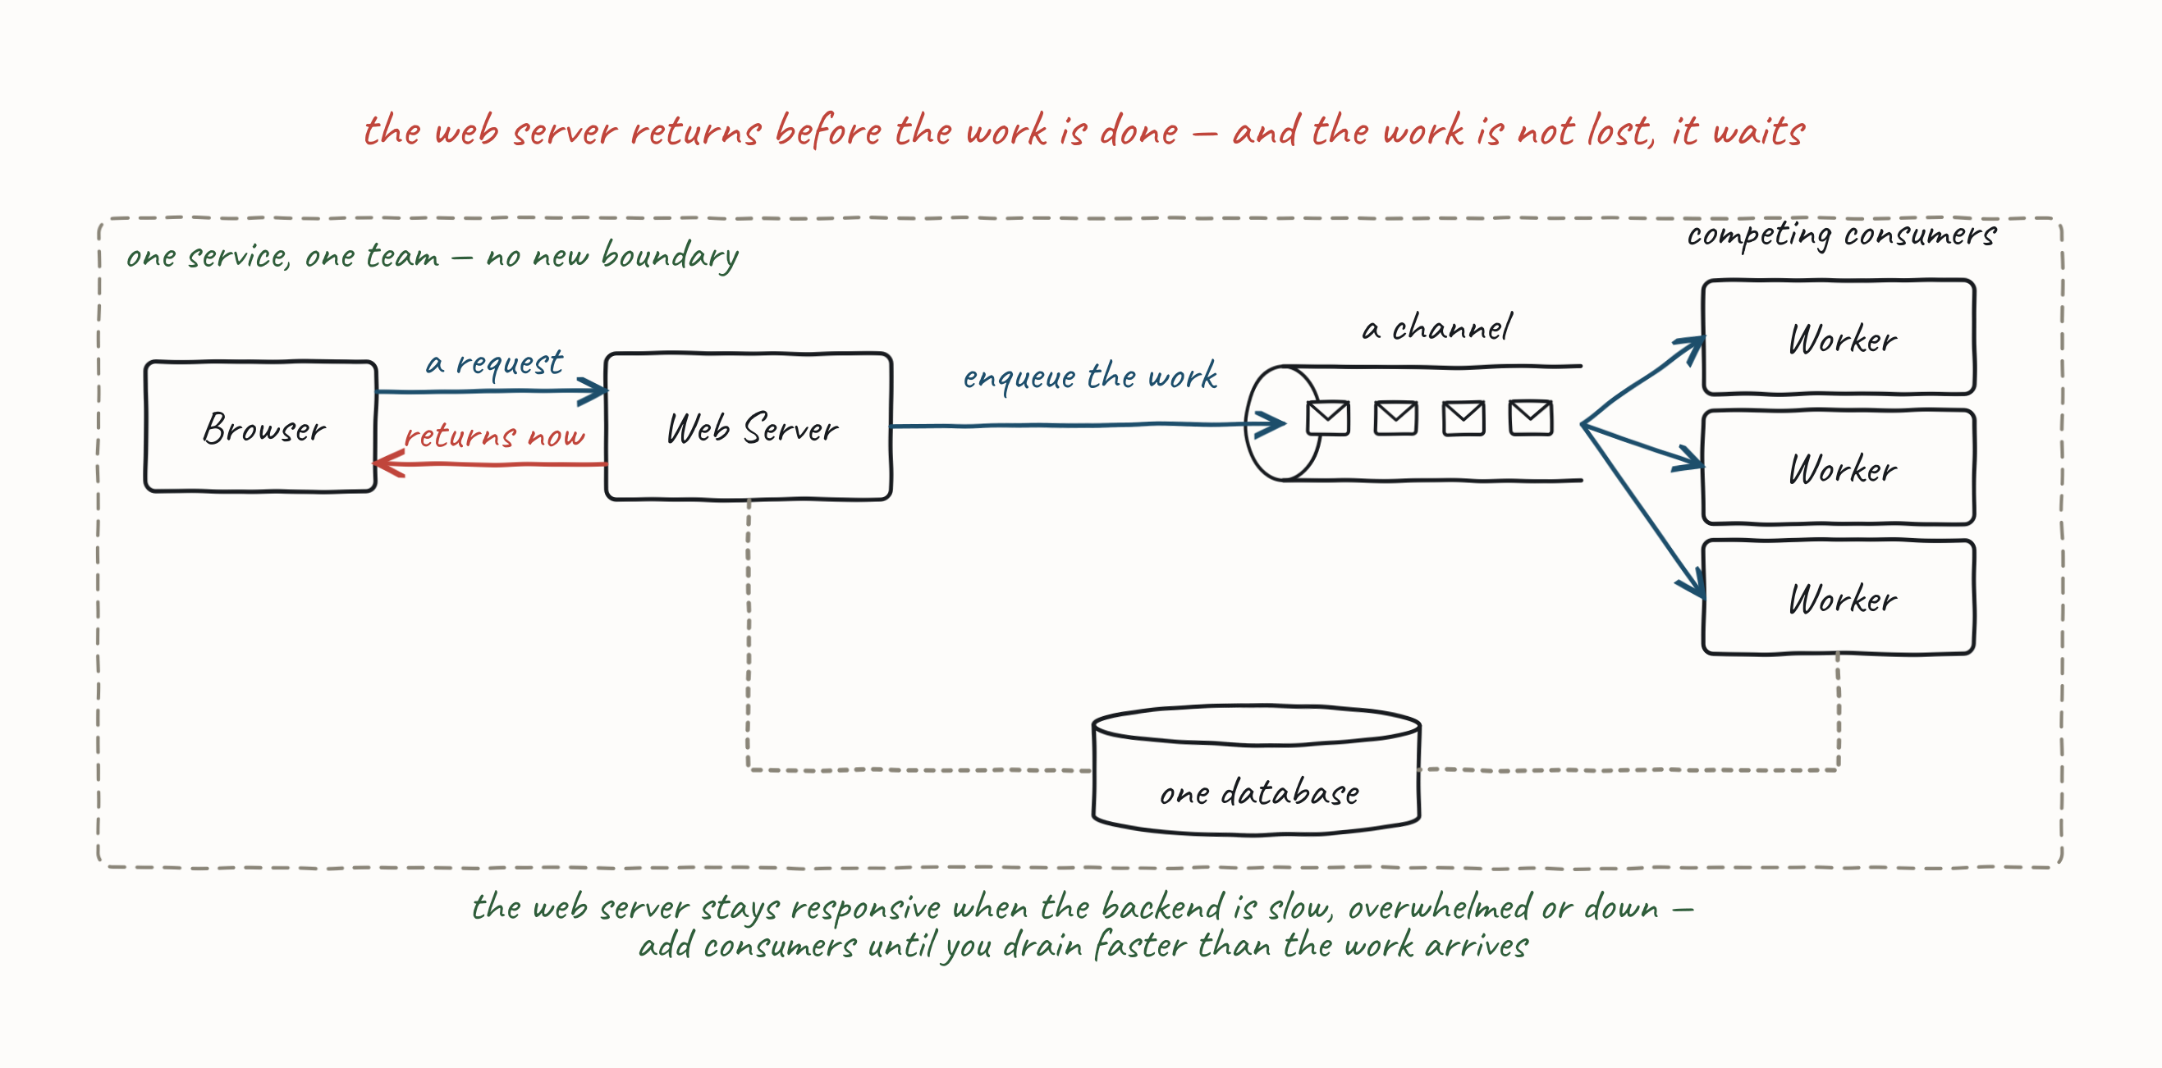
4.3 THE MESSAGE PUMP
Worked Example — the Task Queue
This is the shape the opener promised. One team, one service, one queue — and here are its parts.
52
Notes:
The opener kept the want — Robust — Guaranteed Delivery — and this is the mechanism, which belongs here, where the parts have names. Everything that slide gestured at vaguely in the first ten minutes is now vocabulary the room owns: channel, pump, competing consumers. Call the callback out loud — this is the promise from the first ten minutes, and now they can read how it is kept.

Slide 53
4.3 THE MESSAGE PUMP
Task Queue — HTTP Flow
How this looks over HTTP — and most delegates have not used it.
Return 202 Accepted — we have your work request and we will not lose it. It is HTTP's own way of saying store and forward.
•
Enqueue a work item for the request.
•
Return a Location header so the caller can monitor progress: a link to the resource — 404 until it is created — and a link to a progress page backed by a KV store where we note progress.
•
The backend does the work at a sustainable pace and updates the KV store as it goes.
•
53
Notes:
Ask who has returned a 202 in anger — usually a handful of hands. This is one of the most immediately usable things in the course: guaranteed delivery with no new infrastructure and no reorganisation, expressed in a protocol everyone in the room already ships. The callout is the set-up for §4.4 — the web server has promised not to lose the work, and the very next sub-topic is the fact that nothing so far actually guarantees it. The exercise slot now sits between the two, so land the promise before they go to the keyboard and pick it up again when they come back: they will have built the pump that is about to be shown to be unreliable.

Slide 54
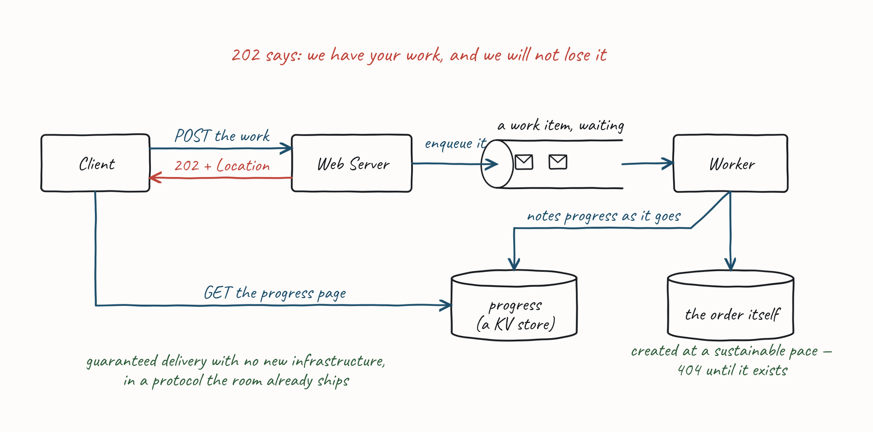
4.3 THE MESSAGE PUMP
Task Queue — HTTP Flow
§4.4 is how you keep that promise.
54
Notes:
Ask who has returned a 202 in anger — usually a handful of hands. This is one of the most immediately usable things in the course: guaranteed delivery with no new infrastructure and no reorganisation, expressed in a protocol everyone in the room already ships. The callout is the set-up for §4.4 — the web server has promised not to lose the work, and the very next sub-topic is the fact that nothing so far actually guarantees it. The exercise slot now sits between the two, so land the promise before they go to the keyboard and pick it up again when they come back: they will have built the pump that is about to be shown to be unreliable.

Slide 55

4.3 THE MESSAGE PUMP
Exercise Material — Introduction & RMQ
Readme, videos, scripts & slides. Introduction to Exercises; Quick Start RabbitMQ — the AMQP 0-9-1 primitives (exchanges, bindings, queues) behind the channels of §4.2.
Then build the thing you have just been shown: a producer, and a consumer with a message pump — mapper, handler registry, and a handler that knows nothing about messaging.
55
Notes:
Get RMQ up before they need it — the compose file is in the pack and the pull is slow on venue wifi, so say this before the break, not after it. The Quick Start covers exchanges, bindings and queues, which is §4.2's channel material in AMQP's own vocabulary; it is precursor reading, not an exercise. The exercise itself is this sub-topic made real, and the piece to watch for is the last one: a handler that takes a domain type and returns, with the messaging kept on the other side of the mapper. If their handler has a broker type in its signature, the mapper is not finished.

Slide 56
PRACTICAL MESSAGING — DAY ONE
4.4 Guaranteed Delivery
How do I stop losing messages — on the way out, and on the way in?
56

Slide 57
4.4 GUARANTEED DELIVERY
Guaranteed Delivery
Coming from HTTP, a failed call is obvious: you get a status code, or a timeout, and you decide what to do. Messaging hides the failure. The send returns, and you find out later — or never.
Two halves, and you need both:
Producer side — did the message actually get out, given the entity write and the send are not in the same transaction?
•
Consumer side — what happens to a message my code cannot process, and how do I stop it taking the consumer down with it?
•
"Sent" is not "delivered", and "delivered" is not "processed".
57
Notes:
Set the expectation that these are broker capabilities before they are framework features — What Your Broker Actually Gives You, at the end of this sub-section, comes back to what is native versus what your framework is quietly reimplementing for you. Delegates who have only used HTTP tend to assume the library is telling them the truth.

Slide 58
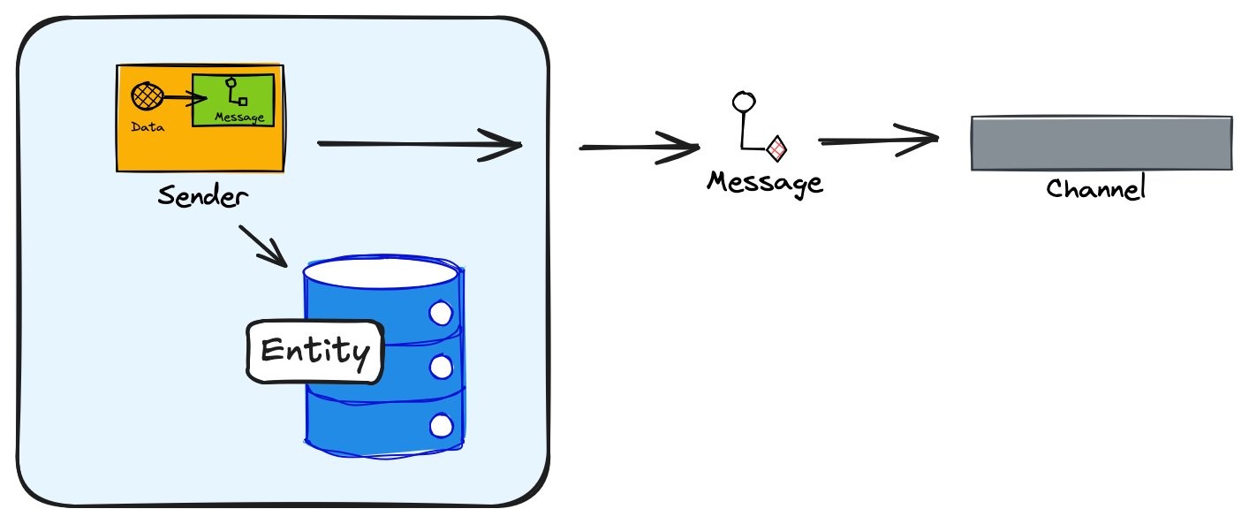
THE PRODUCER SIDE — DID THE MESSAGE GET OUT?
The Dual-Write Problem
No transaction spans both my write to the DB for an entity and my sending of a message.
If the message send fails, downstream systems become inconsistent with upstream.
•
If we reverse the operations and the message sends but the DB write fails, upstream is inconsistent.
•
58
Notes:
Call straight back to the opener — Messages In, Private Data, No Shared Transaction said this would happen; this is the first place it actually bites. There is no clever ordering that fixes it; one of the two writes is always unprotected.

Slide 59
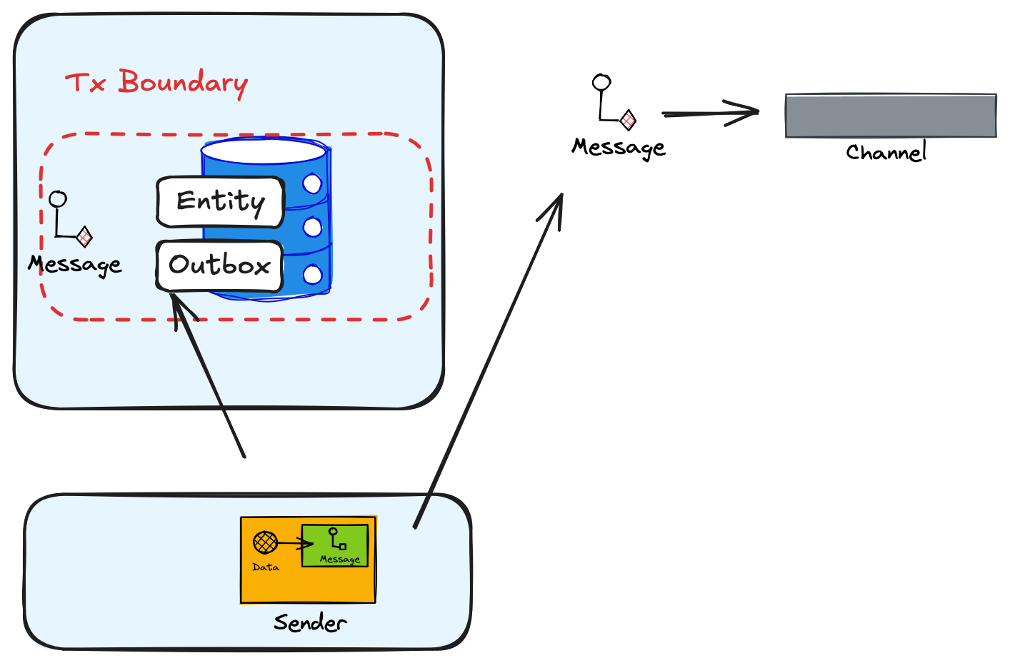
THE PRODUCER SIDE — DID THE MESSAGE GET OUT?
Outbox
Instead of writing directly to the channel:
Open a transaction, update the entity, and write the message to send to an Outbox table as Pending.
•
Once sent, mark the message Sent in the Outbox.
•
A background "sweeper" runs at an interval to flush any Pending items (over an age) from the Outbox.
•
To reduce latency, also send from the application right after writing, with the sweeper as backup.
•
The outbox guarantees at-least-once. Which is a polite way of saying: you will send duplicates.
59
Notes:
Say where the duplicate comes from, because it is no longer on the slide. We can fail after the send and before marking it Sent; the sweeper then finds it Pending and sends it again. That is the whole of at-least-once, and it is what the callout means. Do not let this land as a footnote — it is the question the Inbox exists to answer, and Inbox (Idempotency) answers it, on the consumer side. Leave the duplicate hanging deliberately: ask the room what they would do about it, take answers, and tell them you will come back to it when we are on the consumer side, because that is where it gets fixed. People from an HTTP background often assume the framework has already solved it.

Slide 60
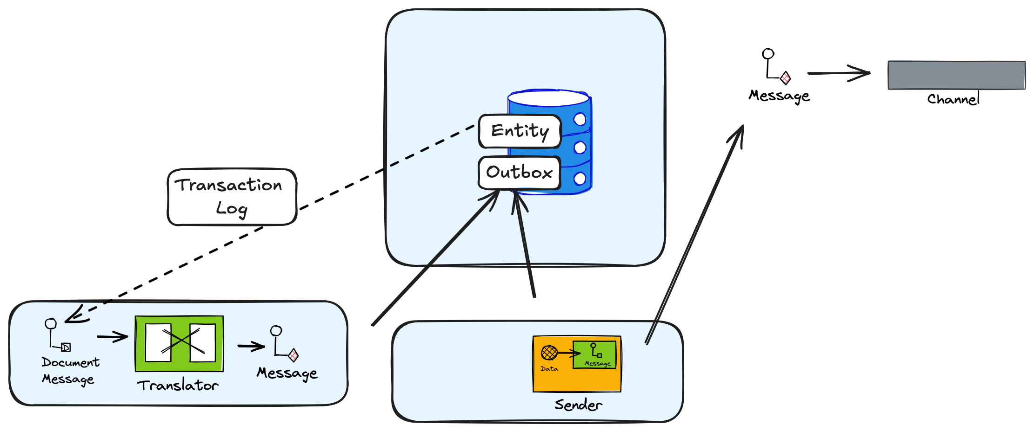
THE PRODUCER SIDE — DID THE MESSAGE GET OUT?
Log Tailing (Change Data Capture)
No ACID transaction across the Outbox and the entity tables? Tail the transaction log instead.
The naive version, and the one CDC tooling makes trivially easy:
transaction log → broker. Done.
The problem: your table schema is now your published contract. Every column rename breaks consumers you have never met.
Instead, the log tail feeds an anti-corruption layer: read the log, run the mapper, write the message to the Outbox, then sweep as before.
Change Data Capture without an anti-corruption layer publishes your schema. The write to the Outbox is the layer.
60
Notes:
And if the broker is down the log tail blocks — the naive version has a liveness problem as well as a coupling one. Walk the four steps against the picture — read the transaction log; run the mapper, which translates the row change into a message in your published language; write that message to the Outbox; sweep the Outbox exactly as before. Step two is the whole of it. This is the discussion that always happens in the room and never makes it onto the slide — put it on the slide. CDC tooling makes step-one-straight-to-broker so easy that teams adopt it with no thought about coupling at all. Tie it back to §Coupling explicitly: publishing your table schema is common coupling wearing a message's clothes — you have rebuilt Shared Database, only now it is asynchronous and you cannot see the consumers. The mapper plus the Outbox write is what buys you back the data coupling you wanted.

Slide 61
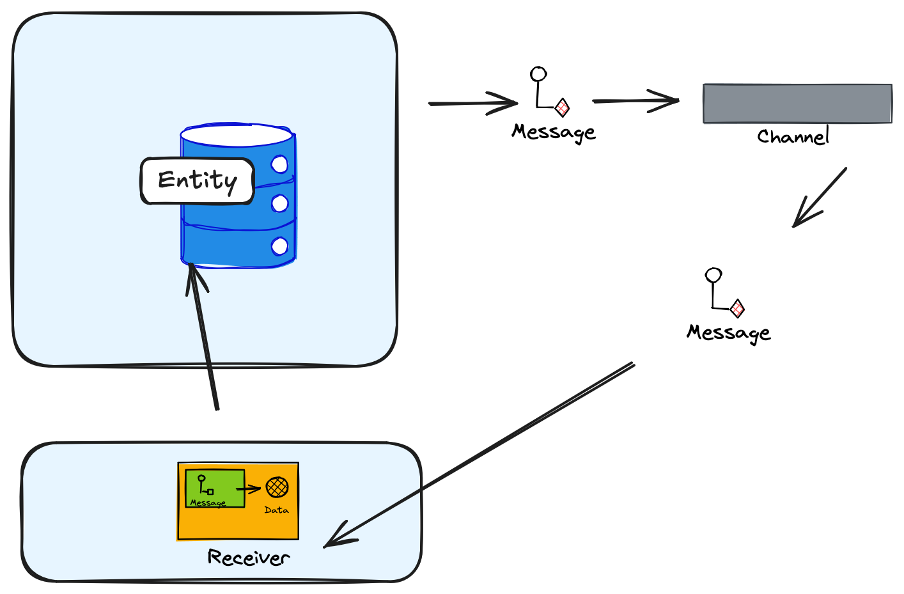
THE PRODUCER SIDE — DID THE MESSAGE GET OUT?
State Change Capture
A low-cost alternative: send the message before writing the entity. If the message sends, delivery is guaranteed. Read the message back from the channel and then update the entity. The main issue: you must cope with eventual consistency, which isn't always simple.
61

Slide 62
THE CONSUMER SIDE — WHAT THE PUMP CANNOT ACK
When the Handler Fails — Ack and Nack
The pump reads a message and calls your handler. The handler throws. Now what?
The pump has exactly one lever: acknowledge the message, or don't.
Ack — I am done with this. The broker may forget it.
•
Nack — I am not done. The broker keeps it, and will hand it to someone again.
•
Ack too early and a crash loses the message. Ack too late and a crash reprocesses it. There is no third option — which is why at-least-once stops being a slogan on the consumer side.
62
Notes:
Do not underestimate this conversation. Run it as a discussion before showing anything: ask what their consumer does today when the handler throws. The usual answers are "it logs and moves on" — silent data loss — or "it retries forever" — the poison pill. Both are the thing the rest of this sub-section exists to prevent, so take the answers before you offer any. This is the natural place to define poison message.

Slide 63
THE CONSUMER SIDE — WHAT THE PUMP CANNOT ACK
Not Acking — Requeue or Reject
Not acking is two decisions, not one. Which one you take is a policy — you set it in advance, and most teams never do.
Requeue — put the message back on the queue. Someone tries it again.
•
Reject — do not process this message at all. Delete it on a queue; skip it on a stream.
•
Each of the two has to end somewhere:
On a requeue, set a policy for how many attempts. Exceed it and the message goes to the Dead Letter Channel.
•
On a reject, a badly formed message goes to the Invalid Message Channel.
•
A well-formed message you reject may go straight to the Dead Letter Channel — by policy, and it is your policy.
•
63
Notes:
This slide is what turns the next three from a list of patterns into two answers. Requeue is "not now"; reject is "not ever, not by me". The limit on a requeue and the destination of a reject are both configuration, and teams routinely ship neither — which is how a poison message ends up retried until someone notices the lag. Ask which of the two their broker does by default; most rooms find out they have been requeueing forever.

Slide 64
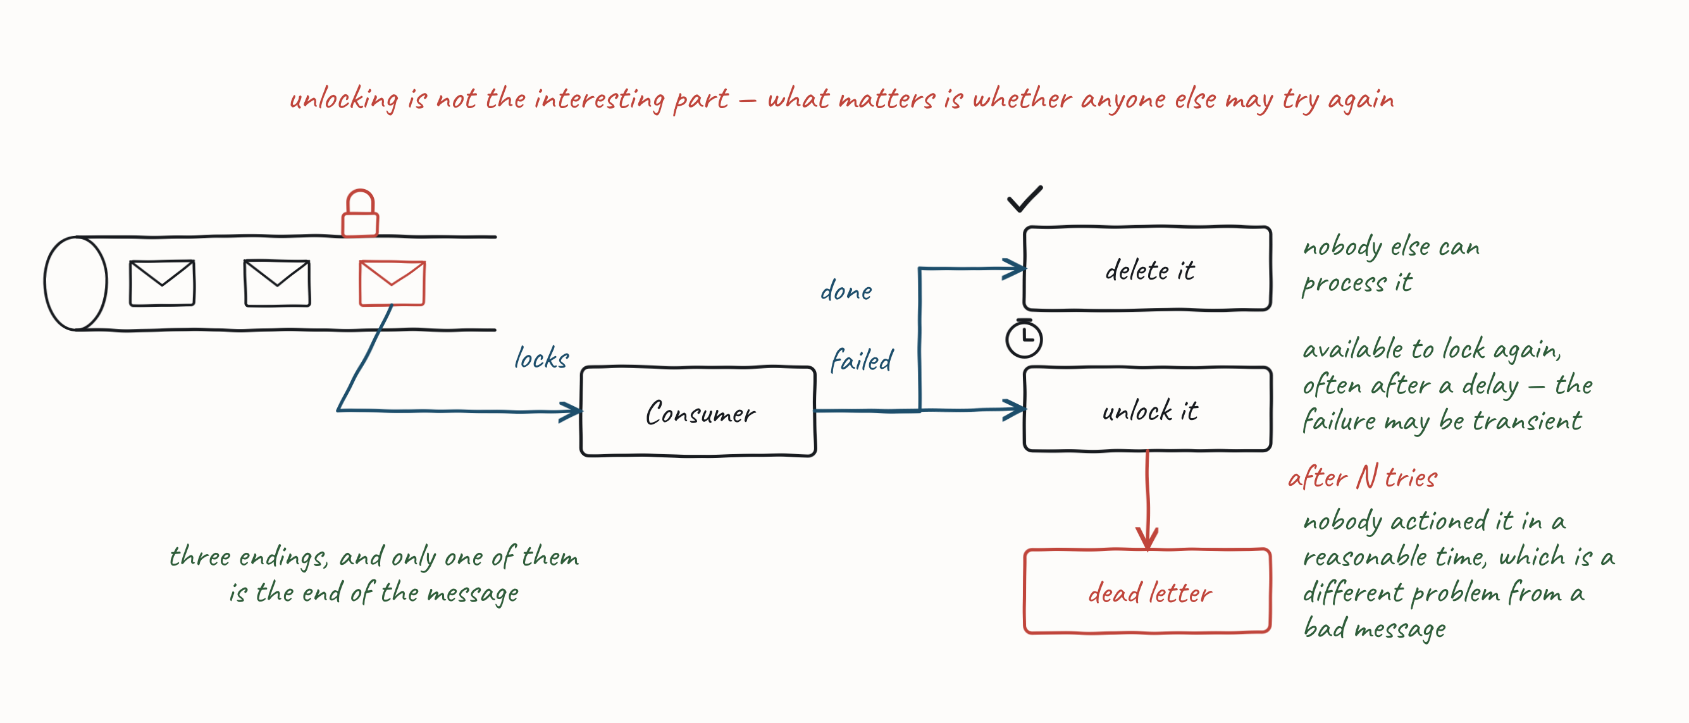
THE CONSUMER SIDE — WHAT THE PUMP CANNOT ACK
Not Acking — Requeue or Reject
A message that is only ever nacked blocks the queue forever. Requeue and reject both have to end somewhere.
64
Notes:
This slide is what turns the next three from a list of patterns into two answers. Requeue is "not now"; reject is "not ever, not by me". The limit on a requeue and the destination of a reject are both configuration, and teams routinely ship neither — which is how a poison message ends up retried until someone notices the lag. Ask which of the two their broker does by default; most rooms find out they have been requeueing forever.

Slide 65
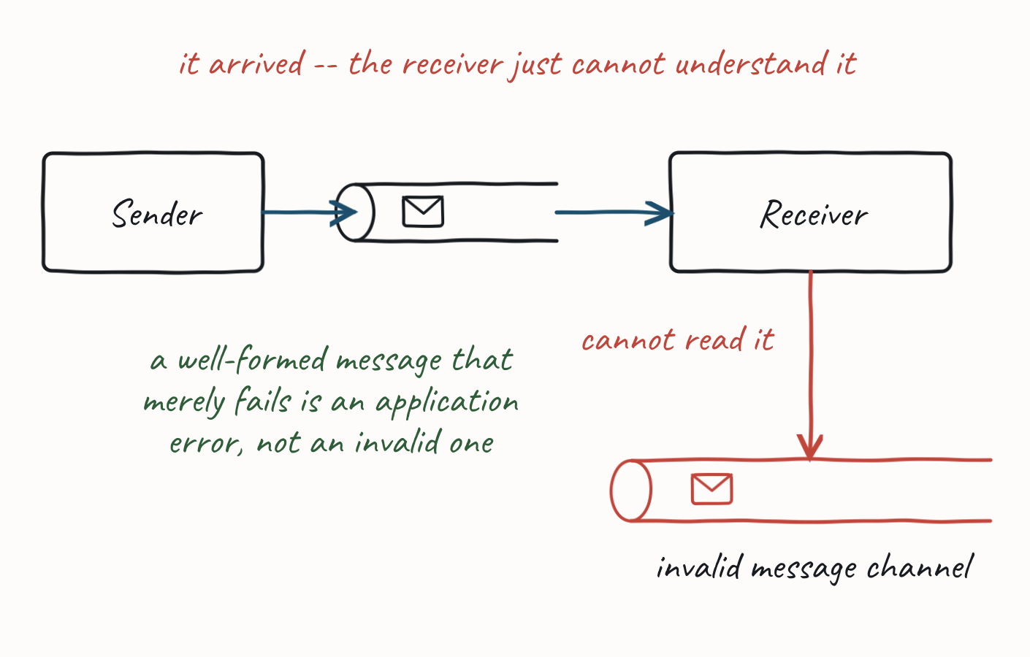
THE CONSUMER SIDE — WHAT THE PUMP CANNOT ACK
Invalid Message Channel
What happens when a delivered message cannot be understood (missing headers, wrong content type, schema mismatch)?
Needs from the broker: the ability to take the message off the channel and put it somewhere else without pretending it was processed.
Dead Letter: we could not deliver it. Invalid Message: we delivered it and could not read it.
65
Notes:
Retrying a message that cannot be read keeps failing — it becomes a "poison pill", blocking one consumer or being choked on by many. But silently discarding it risks data loss: a misconfigured producer may have put a perfectly good message on the wrong channel. So route it aside rather than dropping it. Some middleware conflates the two terms — RabbitMQ calls rejected messages "dead letter", which matters because the Failing Well exercise uses RMQ's own dead-letter exchange.

Slide 66
THE CONSUMER SIDE — WHAT THE PUMP CANNOT ACK
Requeue with Delay — a Queue Capability
Transient failure is not the same as permanent failure. The downstream service is restarting; the database is failing over. The message is fine — you just tried at a bad moment.
If work isn't done/acked, make it available again to the next consumer.
•
If it failed for a transient reason, delay to let that pass.
•
After a number of re-queues, move to a dead-letter channel.
•
Needs from the broker: per-message acknowledgement, a redelivery mechanism, and a way to hold a message back for a period. The lock is what supplies all three, and only a queue has one — which is what the slide after Dead Letter Channel is about.
66

Slide 67
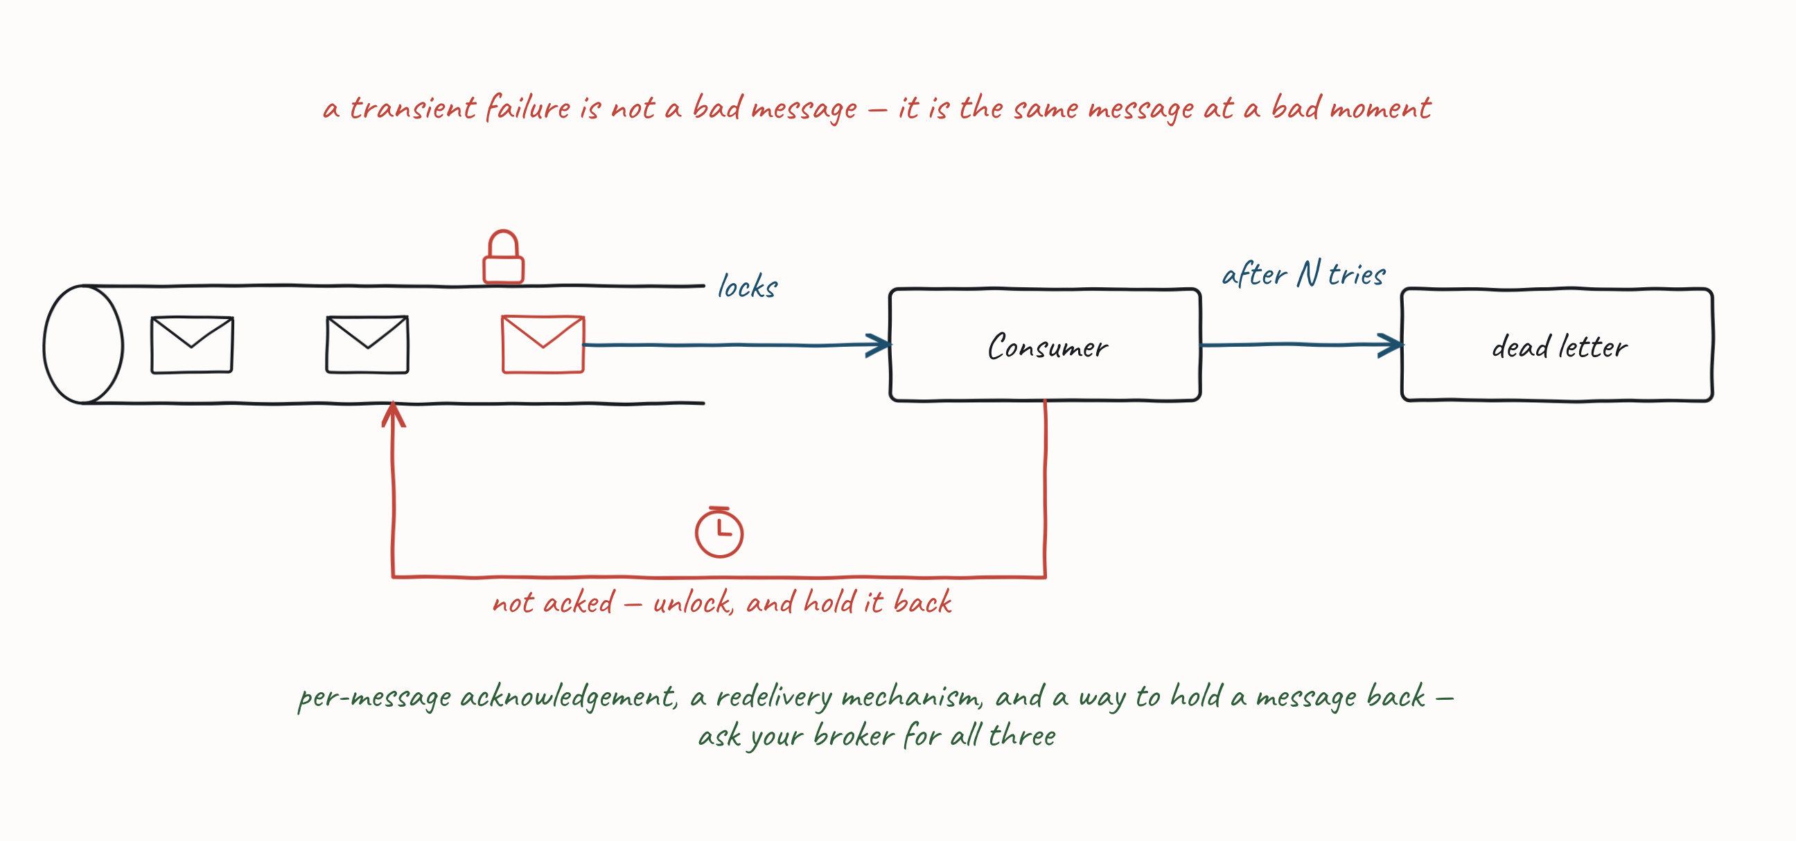
THE CONSUMER SIDE — WHAT THE PUMP CANNOT ACK
Requeue with Delay — a Queue Capability
67

Slide 68
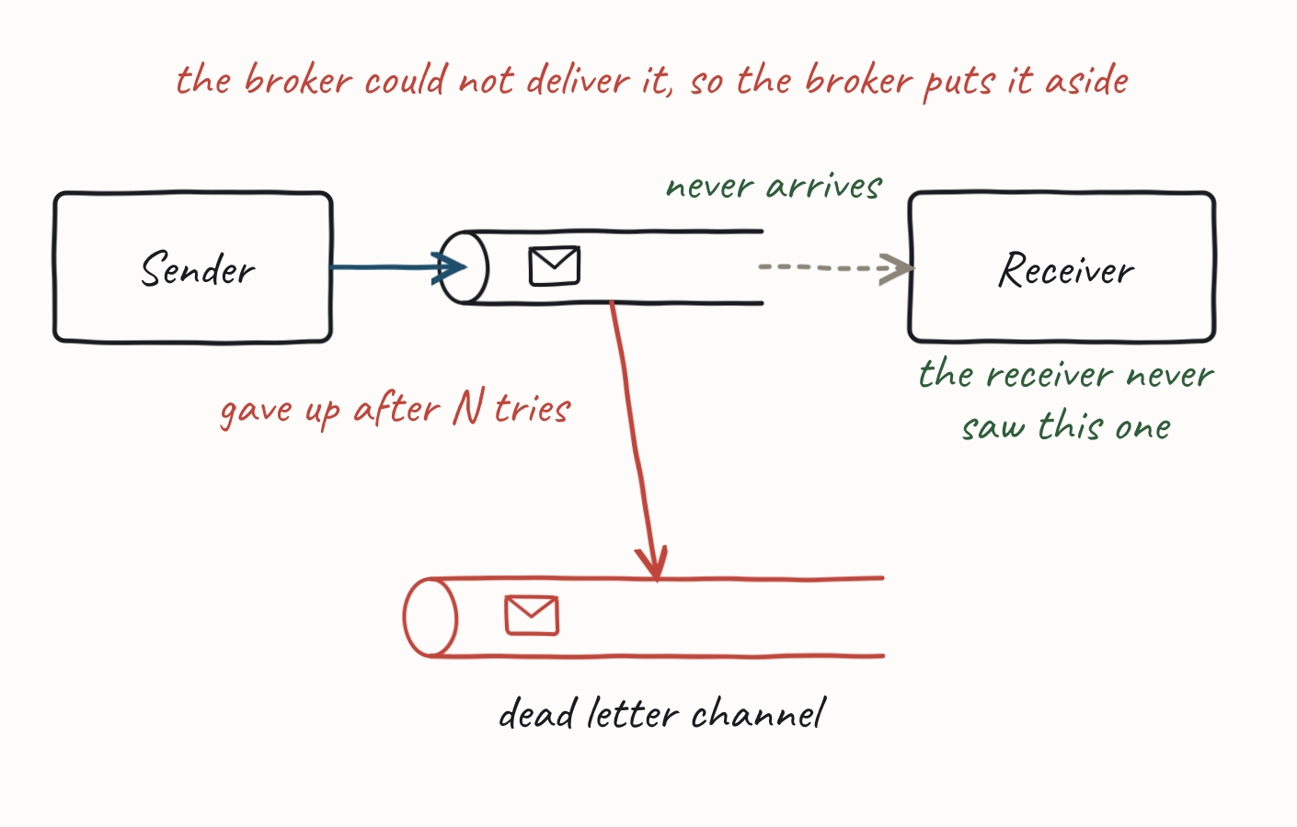
THE CONSUMER SIDE — WHAT THE PUMP CANNOT ACK
Dead Letter Channel
What does the middleware do with a message it cannot deliver to the intended channel? It may move it to a Dead Letter Channel for later operator review, often after retrying delivery a number of times.
Needs from the broker: somewhere to put the undeliverable message, and a rule for when to give up.
68
Notes:
Implementations vary (point-to-point or pub-sub). This is the terminal state — the place a message goes when Requeue with Delay has run out of attempts, which is why it now follows rather than precedes it. The line that separates it from the Invalid Message Channel is on that slide; this is the one to point at when someone asks which of the two RabbitMQ means. (EIP reference.)

Slide 69
THE CONSUMER SIDE — WHAT THE PUMP CANNOT ACK
Streams — No Requeue or DLQ
Invalid Message Channel, Requeue with Delay and Dead Letter Channel all needed the broker to hold a message for you. A stream has no lock, so it has no requeue, no requeue-with-delay and no dead-letter channel. What you have instead:
Ignore and continue — load shedding. The record is gone and the partition moves on.
•
Retry in place — backpressure. The partition stops until it succeeds.
•
Copy to another stream — a delay stream or a DLQ stream, and a scheduler to feed it back.
•
The third one is the closest thing to requeue-with-delay, and it costs you the thing partitioning bought: the record comes back at the end. You have de-ordered the stream to get a retry.
69
Notes:
This is the slide that makes What Your Broker Actually Gives You land, and it is the setup for the Kafka exercise: none of §4.4 is native here. Ask what their framework does — most will find it retries in place by default, which means one bad record stops a partition and the lag graph is the only symptom. The three alternatives are a choice about which guarantee you are willing to lose: the record, the throughput, or the ordering.

Slide 70
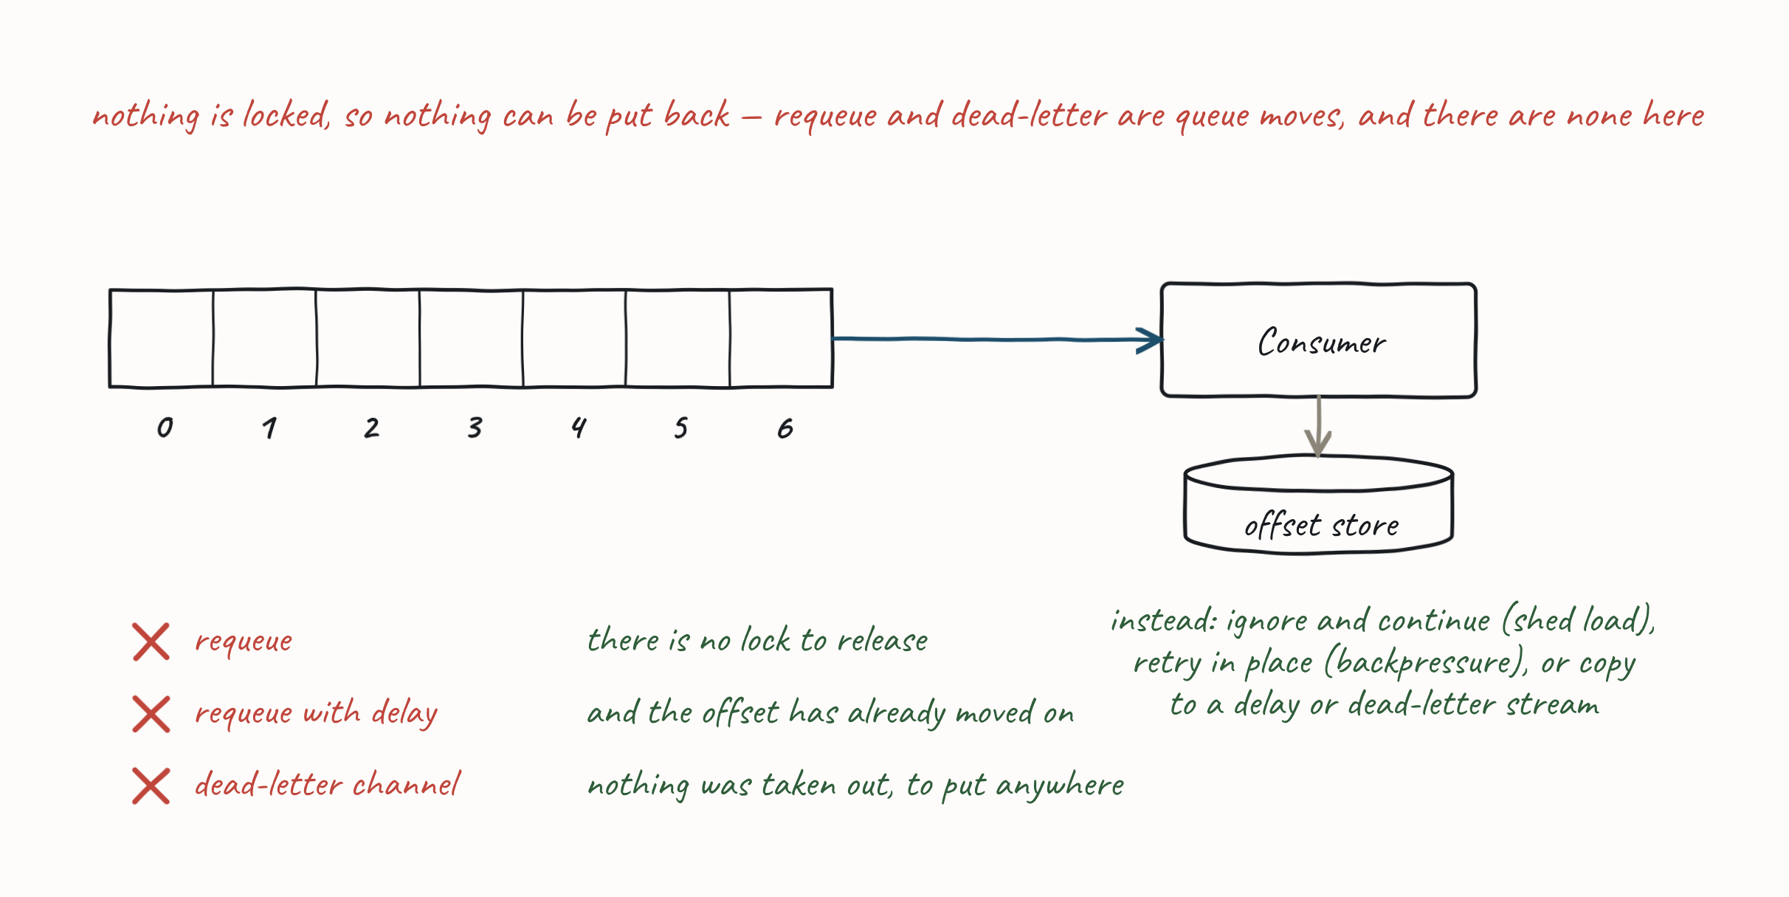
THE CONSUMER SIDE — WHAT THE PUMP CANNOT ACK
Streams — No Requeue or DLQ
On a queue the broker holds the message for you. On a stream, whatever holds it is code you wrote.
70
Notes:
This is the slide that makes What Your Broker Actually Gives You land, and it is the setup for the Kafka exercise: none of §4.4 is native here. Ask what their framework does — most will find it retries in place by default, which means one bad record stops a partition and the lag graph is the only symptom. The three alternatives are a choice about which guarantee you are willing to lose: the record, the throughput, or the ordering.

Slide 71
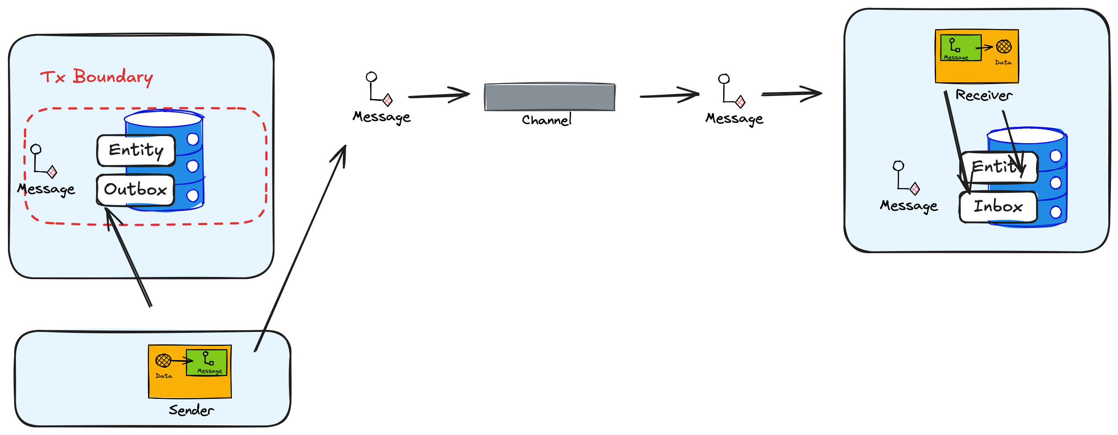
THE CONSUMER SIDE — WHAT THE PUMP CANNOT ACK
Inbox (Idempotency)
One more thing the pump has to decide, and this one comes from the producer side: have I seen this message before?
The Outbox bought at-least-once, so duplicates are not a risk — they are a certainty. This is where you pay for it.
If the message isn't idempotent (not side-effect free), use an Inbox to record messages seen (working on) and processed (may fail).
Producer-side reliability creates a consumer-side obligation — the two halves are one design.
•
If the handler is naturally idempotent, you do not need an Inbox. Most aren't.
•
71
Notes:
The Inbox is consumer-side machinery answering a producer-side consequence — it is part of the pump, but it only matters once we have the Outbox, which is why it sits here rather than alongside it. Keep that callback. Exactly-once delivery does not exist; exactly-once processing is what the Outbox/Inbox pair gives you. It is the last item on this sub-section's list, and the only one that is not about failure.

Slide 72
THE CONSUMER SIDE — WHAT THE PUMP CANNOT ACK
What Your Broker Actually Gives You
Everything in this sub-section is a broker capability first. Frameworks backfill the gaps — which is fine, until you assume it is native and reason about failure as though it were.
Capability | RabbitMQ (queue) | AWS SQS (queue) | Kafka (stream)
Per-message ack / lock | Ack / nack | Visibility timeout | None — offsets only
Dead letter | Dead-letter exchange, native | Redrive policy, native | None — framework writes a separate topic
Delay / retry | TTL + DLX, or delayed-message plugin | Delay queues + per-message delay, native | None — framework uses retry topics
Redelivery count | Header, by convention | Receive count, native | None — framework tracks it
Ordering | Per queue | FIFO queues only | Per partition
If your framework offers you a DLQ on Kafka, it built one. Know which of these you are relying on.
72
Notes:
This slide is the honest answer to "why does my library make this look so easy?" — it puts a price on the queue-versus-stream distinction §4.1 drew, and it explains why the same reliability pattern costs very different amounts on different infrastructure. Ask the room which broker they are on and what they assumed was native. The second exercise slot follows this slide, so this is the last thing they hear before making their own pump fail — which is the right note to send them out on.

Slide 73
THE CONSUMER SIDE — WHAT THE PUMP CANNOT ACK
Exercise Material — Failing Well
Take the pump you built and make it survive the ways this sub-topic says it will fail: a message that cannot be mapped, and a message that fails handling n times. Use RMQ's own dead-letter exchange rather than building one.
Two different failures, two different answers — and the pump has to tell them apart.
73
Notes:
The callout is the whole exercise. A body that will not map is never going to map, so retrying it is a poison pill — it goes straight to the invalid message channel. A handler that failed may simply have been unlucky, so it is requeued with delay and only dead-lettered when the count runs out. That distinction is §4.3's failure to understand versus failure to process, and it is the one thing to check they have got. Have them watch the management console while it happens — the unacked count, the retry count, and the x-death header on what lands in the DLQ.

Slide 74
PRACTICAL MESSAGING — DAY ONE
4.5 Queues and Streams
The two things only one of them can do — and the summary you take away.
74

Slide 75
4.5 QUEUES AND STREAMS
Scaling Streams — Consumer Groups
You partitioned the stream in §4.3 and gave each partition a consumer. A consumer group is how the broker keeps that assignment true while consumers come and go.
Only one consumer in a group reads from a partition at a time — that is what protects the ordering partitioning bought you.
•
A consumer may hold more than one of the group's partitions, so a group survives losing a member.
•
75

Slide 76
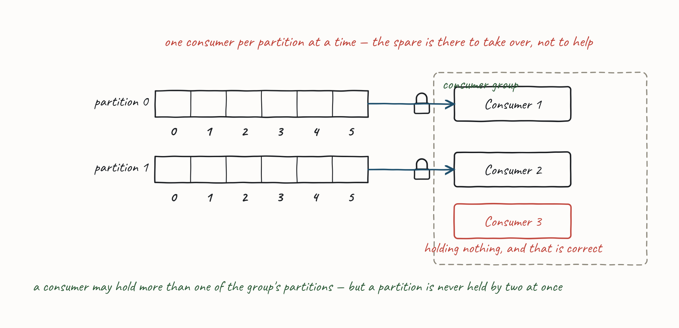
4.5 QUEUES AND STREAMS
Scaling Streams — Consumer Groups
Partitions decide the ordering. Consumer groups decide who is holding them right now.
76

Slide 77
4.5 QUEUES AND STREAMS
Archive and Replay
Can we re-read the past? The two models answer differently, and the answer follows from what §4.1 said each one is: a queue holds work to be done, and work that is done is gone.
77

Slide 78
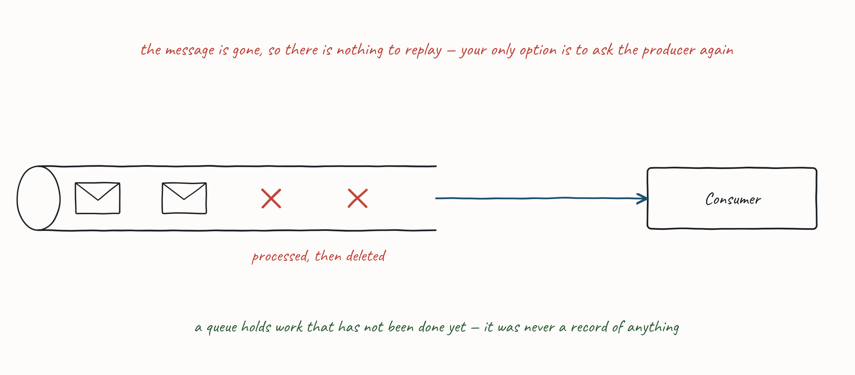
4.5 QUEUES AND STREAMS
Queues — No Archive and Replay
With queues we delete a message once the action completes, so there's no way to replay a work request — our only option is to ask the producer to resend.
78

Slide 79
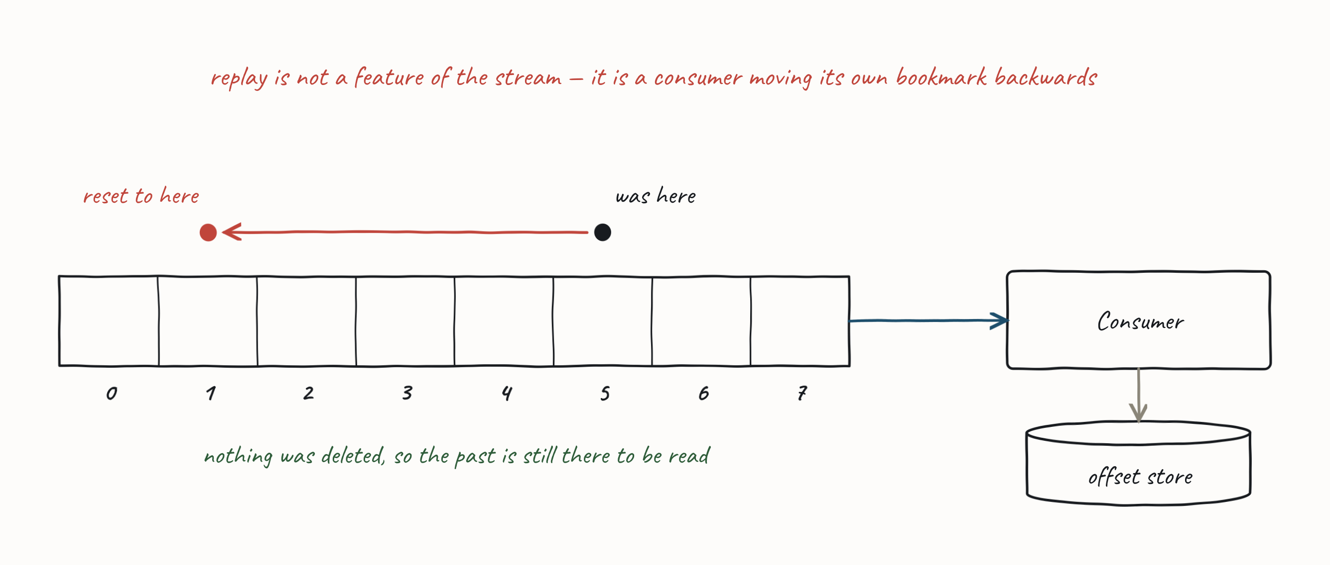
4.5 QUEUES AND STREAMS
Streams — Archive and Replay
Straightforward, because nothing is deleted: reset the consumer's offset to re-read the stream.
79

Slide 80
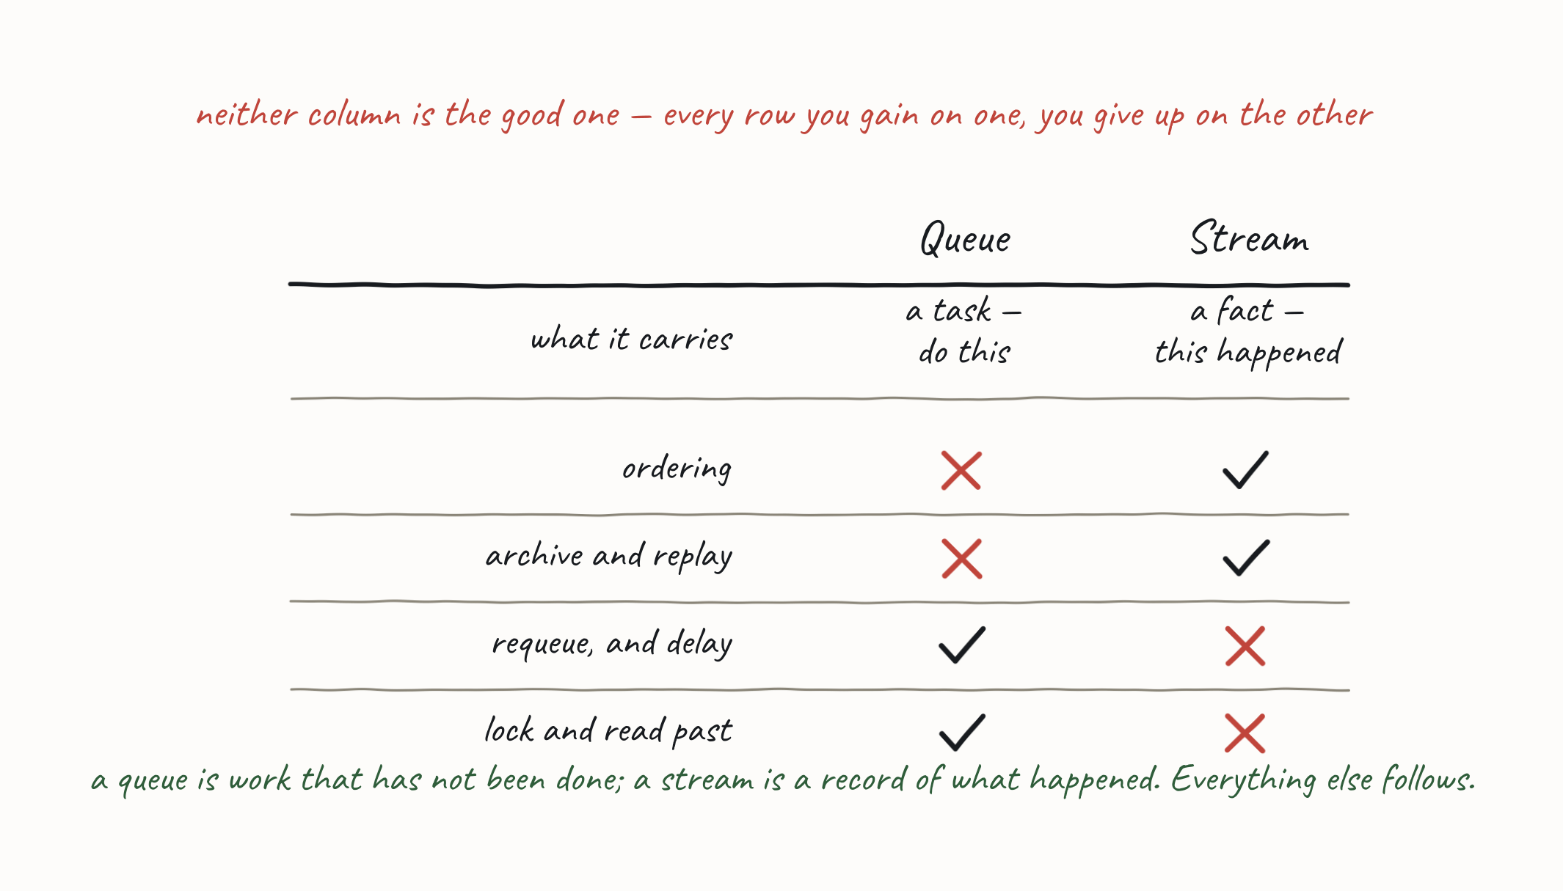
4.5 QUEUES AND STREAMS
Queues vs. Streams — Capability Matrix
Summary comparison across: Messaging (Discrete Event vs. Series Event), Ordering, Archive and Replay, and Requeue with Delay — for Queue vs. Stream.
80

Slide 81
4.5 QUEUES AND STREAMS
Exercise Material — Introduction to Kafka
Readme, slides. Quick Start Kafka — brokers, topics, partitions, consumer groups, offsets.
Then the exercises: take the reliability you built on a queue and get the same guarantees on a stream. Nothing you relied on in §4.4 is native here.
81

Slide 82
PRACTICAL MESSAGING — DAY ONE
Conversations
From single messages to conversations — choosing an exchange pattern.
82

Slide 83
CONVERSATIONS
Messaging Participants
You can now send a message, receive it, and not lose it. Real interactions are rarely one message — they are conversations, and the shape of the conversation is a design decision.
An application acts as either a requestor or a provider.
Prefer requestor/provider over producer/consumer here, because they name the role: are you providing the API, or using it?
•
A channel is unidirectional. A two-way conversation needs two channels — and that one fact forces every pattern in this section.
•
Example. Provider (Store Information) manages stores for our ecommerce site. Requestor (Search) registers a store and optimizes for fast lookup on key search terms. The message changedstore() indicates new store details.
83
Notes:
The problem with producer/consumer is that either one can be the side exposing operations — the consumer receives a command, or the producer sends a notification — so the words tell you nothing about who is offering the API. Say what the one-way channel costs: if you want an answer you have to open a second channel, and that is a decision with consequences, not a detail.

Slide 84
CONVERSATIONS
Messaging or Eventing?
The first question, before any pattern, and you met it in §4.1: are you expressing intent, or reporting a fact? Here is what it decides.
 | intent — Messaging | a fact — Eventing
patterns available | In-Only, In-Out | Out-Only
who you are addressing | someone: you know who should act | nobody: the subscriber list is not yours
what you are coupled to | the request or command contract | the event schema
84
Notes:
They met the intent/fact split in §4.1; what is new here is the third column of consequences, so do not re-teach the definition. Tie it back to Integration Styles instead — the same trade, one level down: the loosest coupling on offer is the one where you do not know who is listening, and you buy it by giving up any way to hear back. The figure makes the point physically: the arrow turns round, and In-Out needs two of them because a channel only goes one way.

Slide 85
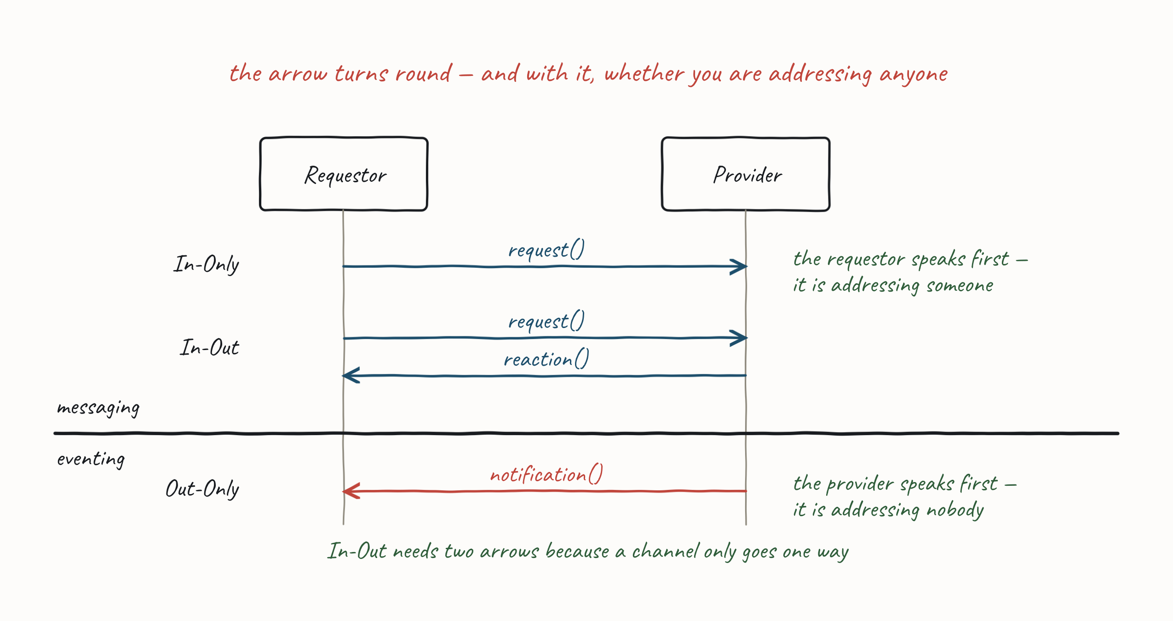
CONVERSATIONS
Messaging or Eventing?
85
Notes:
They met the intent/fact split in §4.1; what is new here is the third column of consequences, so do not re-teach the definition. Tie it back to Integration Styles instead — the same trade, one level down: the loosest coupling on offer is the one where you do not know who is listening, and you buy it by giving up any way to hear back. The figure makes the point physically: the arrow turns round, and In-Out needs two of them because a channel only goes one way.

Slide 86
CONVERSATIONS
The Four Exchange Patterns
Two questions give you all four. Who speaks first — the requestor, or the provider? And is there a message back?
 | no message back | a message back
In — requestor speaks first | In-Only (fire and forget) | In-Out (request-reaction)
Out — provider speaks first | Out-Only (notification) | Out-In (solicit-response)
In and Out are named from the provider's point of view: In = a message arrives, Out = a message leaves.
•
Everything else in this section is one of these four, or a composition of them.
•
86

Slide 87
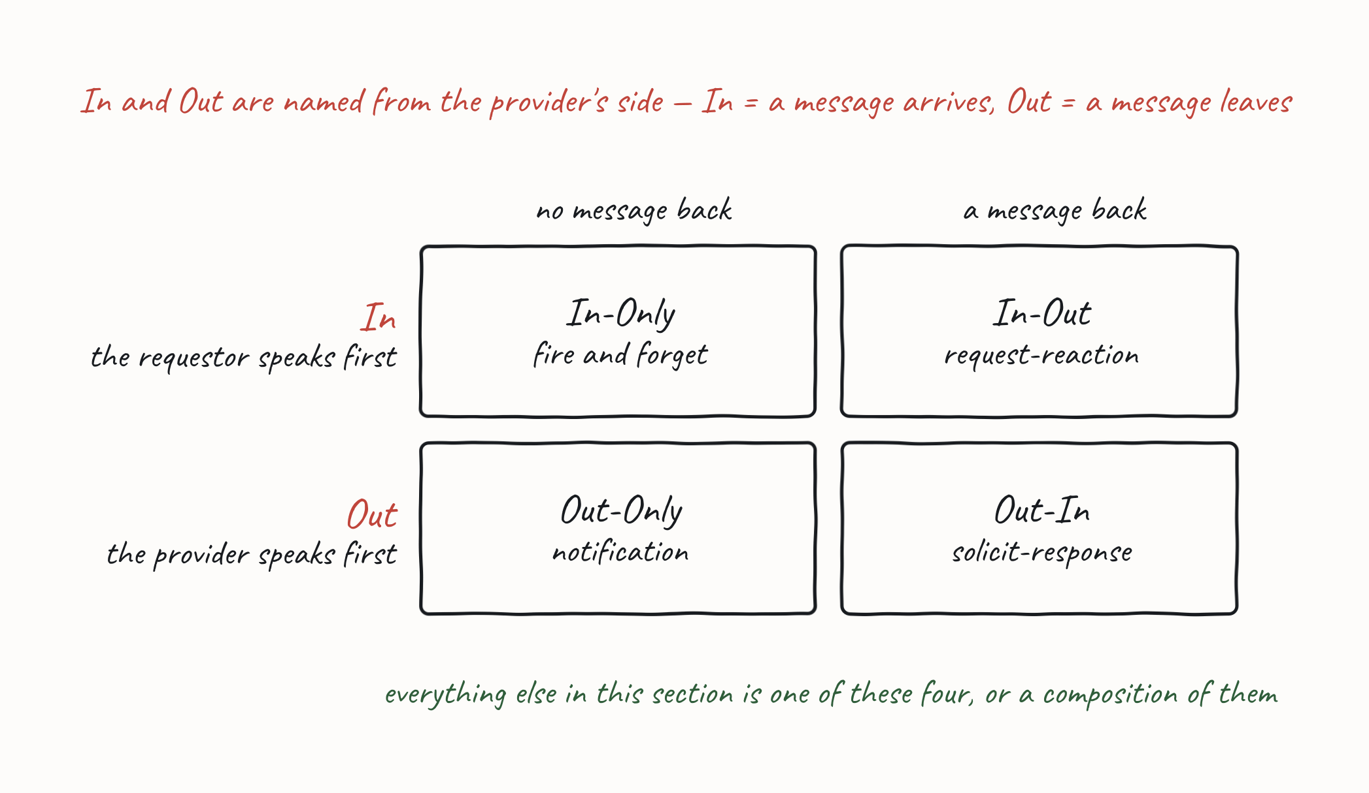
CONVERSATIONS
The Four Exchange Patterns
87

Slide 88
IN-ONLY — FIRE AND FORGET
In-Only (Fire and Forget)
Under In-Only, the requestor sends a request to the provider but does not seek acknowledgment of completion. Typically called fire-and-forget.
Used where we are finished with our part in a flow and are transferring control — we need no response because we are done.
•
Example. Requestor (cashier) has a paid-for basket it wants to turn into an order; provider (order placement) raises an order — place order().
•
What it commits you to
Coupled about: the command contract — you name an operation on someone else.
•
Must you both be up? No. Store-and-forward; the provider can be down.
•
Behavioural (control) coupling: you decided who should act.
•
88

Slide 89
OUT-ONLY — NOTIFICATION
Out-Only (Notification)
Under Out-Only, the requestor subscribes to the provider; an operation is triggered by receipt of a message, but it does not acknowledge the message back to the provider. Out-Only is the Publish-Subscribe pattern: a provider is not aware of its consumers.
Example. Provider (Store Information) manages stores and raises changedstore(). Multiple requestors subscribe: Search (fast lookup), Availability (factors for whether a store is open), Pick-Up Locations (where couriers pick up, and restrictions).
•
Adding a fourth subscriber requires no change to the provider — that is the whole point.
•
What it commits you to
Coupled about: the event schema, and nothing else. No operation is named.
•
Must you both be up? No.
•
The loosest coupling available — and, as Faults, by Pattern shows shortly, that is exactly why it has no fault path at all.
•
89

Slide 90
OUT-ONLY — NOTIFICATION
Subscribe-Notify
In-Out composed with Out-Only: a requestor asks to subscribe to a provider, and then notifications flow.
subscribe() → the provider manages a list of subscribers → optional confirm() / confirmed() (note the role switch — the provider is now the requestor).
•
Then Out-Only notification() messages flow; a stop() ends them.
•
What it commits you to
Behavioural (control) coupling on the subscribe exchange — then the loose coupling of Out-Only for everything after it.
•
The provider now holds subscriber state, which it did not in plain Out-Only.
•
90
Notes:
This is the pattern that shows the four are a basis, not a catalogue — real conversations are compositions. It is also the honest version of "pub-sub is loosely coupled": the subscription itself is coupled; the notifications are not.

Slide 91
IN-OUT — REQUEST AND REACTION
In-Out (Request-Reaction)
Under In-Out, the provider receives a request on one channel and returns a response — from the triggered operation — on a separate channel.
The requestor sets a correlation id (conversation id) in the request header; the provider returns it in the response header, so replies arriving over a separate channel can be matched to the request that caused them.
•
Example. Requestor (Basket) sends checkout() — a command asking the cashier to price a basket. Provider (Cashier) takes payment for the agreed amount and turns the basket into an order, replying successfulpayment().
•
What it commits you to
Coupled about: both the request contract and the response contract.
•
Must you both be up? Not necessarily — as long as you do not block. See Blocking In-Out.
•
Behavioural (control) coupling, and now you hold state: something must remember what the correlation id refers to.
•
91
Notes:
The correlation id is the cheapest thing on the slide and the most consequential. The moment you need one you have a conversation with state in it — and something has to own that state across a process restart.

Slide 92
IN-OUT — REQUEST AND REACTION
Command or Query?
Command-Acknowledgement and Query-Result are the same exchange pattern — In-Out. What differs is the intent of the message, and intent is what decides what you must design for.
 | Command-Acknowledgement | Query-Result
the requestor asks | do this | tell me this
example | Basket → Cashier: checkout() → successfulpayment() | Basket → Delivery: getdeliveryfees() → deliverfee()
provider state | changes | unchanged
retry is | unsafe without idempotency | naturally safe
Both carry behavioural (control) coupling — you named the provider and the operation.
92
Notes:
Worth being explicit that the pattern catalogue does not distinguish these, and that is correct — as an exchange they are identical. It is the intent, back to Messaging or Eventing, that changes the design. Retry safety is the practical tell.

Slide 93
IN-OUT — REQUEST AND REACTION
In-Out — When Nothing Comes Back at All
The requestor may not receive the expected response at all. What can it do?
Set a timeout within which to receive a response.
•
Retry if no response arrives within that window (greet() → greet() → acknowledge()).
•
Because we might send twice, the provider operation must be idempotent, or the consumer must de-duplicate already-seen messages.
•
93
Notes:
Call back to Guaranteed Delivery — this is the Inbox pattern earning its keep. Retry is why de-duplication is not optional: at-least-once delivery and requestor-side retry are two independent sources of duplicates.

Slide 94
IN-OUT — REQUEST AND REACTION
Blocking In-Out (Request-Reply)
The requestor provides a unique Reply-To channel in the request header; the provider uses it for the response, letting the requestor look up the suspended workflow — so a correlation id is not required. The requestor may block on the Reply-To channel while awaiting the reply.
Block, and you have rebuilt RPC on top of a message broker.
What it commits you to
Must you both be up? Yes. This is the one pattern in the set that puts temporal coupling back.
•
Availabilities multiply again — the thing we distributed to avoid, and spent Guaranteed Delivery breaking.
•
You have paid the cost of a broker and kept the failure mode of a synchronous call.
•
When it is still the right answer: an interactive request where a human is waiting and there is no useful "later" — the caller cannot do anything with a response that arrives in ten minutes.
94
Notes:
This is the callback slide for the whole day. Distributed Systems said availabilities multiply; Coupling named the axis; Integration Styles put messaging on the loose end of it; Guaranteed Delivery turned an outage into a delay. Blocking In-Out undoes all of it in one line of code. Delegates will reach for this because it looks like the code they already write — say so, and give them the legitimate case, so the answer is "when", not "never".

Slide 95
OUT-IN — SOLICIT AND RESPONSE
Out-In (Solicit-Response)
Under Out-In, a provider solicits a response from a subscriber and awaits confirmation; the subscriber confirms receipt of the provider's solicitation.
Example. Provider (Delivery) assigns delivery requests to drivers and queries whether a courier is available — solicit() — usually followed by notifications of available work. Requestor (Courier) offers to take jobs depending on location and busyness — ready().
•
Use it when the provider needs to know who is willing before it allocates work.
•
What it commits you to
Coupled about: the solicitation contract. The provider must know subscribers exist, though not who they are.
•
Must you both be up? No — but the solicitation has a useful lifetime. An answer that arrives too late is worthless, which is a timeout problem, not an availability one.
•
95

Slide 96
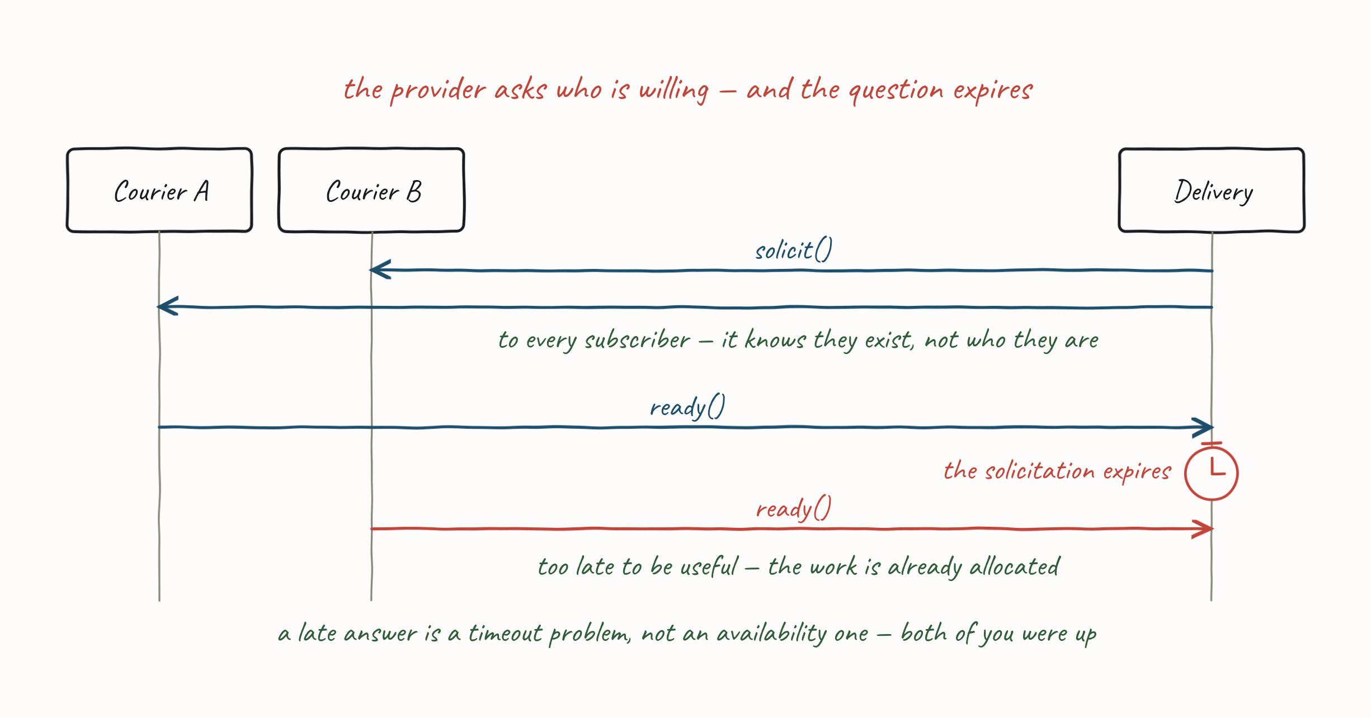
OUT-IN — SOLICIT AND RESPONSE
Out-In (Solicit-Response)
96

Slide 97
ACROSS ALL FOUR PATTERNS
Faults, by Pattern
You have met all four. You do not get to choose their fault stories — the coupling already chose.
pattern | what a fault can be | why
Out-Only | Nothing. No Fault is forced. | The provider does not know its subscribers. There is nobody to tell — and if it did know it would be coupled to them, and you would have traded away the property you chose pub-sub for.
In-Only | No Fault, or Message Triggers Fault (Robust In-Only) — a fault on a reverse channel, because there is no later message to replace | The requestor took no response, so a fault channel is an addition, not a substitution. Add one only if there is an action to take.
In-Out | Fault Replaces Message (Robust In-Out) — any message after the first becomes a fault instead of the normal outcome | There is already a response channel and a correlation id. The fault is a response, not an exception: same channel, same id, same code path.
Out-In | Fault Replaces Message, as for In-Out | Roles reversed, and nothing else — the provider waits.
You cannot have loose coupling and a fault path back. Pick one.
The question is never "should we handle faults?" It is "is there an action the requestor would take?"
97
Notes:
The fault story falls out of the coupling you already chose — which is the payoff of putting a coupling verdict on every pattern slide. Teach it top-down, loosest first, so the room sees the fault path appear as the coupling tightens. There is an example for each row, and they are yours to tell, not the room's to read. Search cannot add a store after changedstore() and makes no attempt to tell Store Information — repair is Search's problem. The cashier sends place order(); if order placement fails it raises fault(), because the cashier may need to issue a refund. The Pricer sends take payment(); the payment provider signals payment error() — and the fault must say why (provider issue, invalid card, insufficient funds), because the requestor has to choose between an alternate payment method and cancelling the order. The decision rule is the load-bearing line — teams reach for fault channels reflexively, and if there is no action the requestor would take, a fault message is noise and a log line is the right answer. No Fault is "good enough" far more often than people admit; say so. Repair on the Out-Only row happens subscriber-side — retries, DLQs and the reconciliation they met in §4.4.

Slide 98
ACROSS ALL FOUR PATTERNS
Choosing an Exchange Pattern
The decision, in order:
Intent or fact? Fact → Out-Only, and accept No Fault. Intent → keep going.
•
Do you need an answer? No → In-Only. Yes → In-Out.
•
Who starts? If the provider needs to canvass its subscribers → Out-In.
•
Do you need the answer now? Only then Blocking In-Out — and know what you just paid.
•
pattern | coupled about | both up? | fault path
Out-Only | the event schema | no | none available
In-Only | the command contract | no | reverse channel, if there is an action to take
In-Out | request + response contracts | no, unless you block | fault replaces the response
Out-In | the solicitation contract | no | fault replaces the response
Blocking In-Out | request + response contracts | yes | fault replaces the response
98
Notes:
Third appearance of the grid — §2 introduced it, §3 plotted the integration styles on it, and now the exchange patterns land on it too. The repetition is deliberate: it is the one picture that carries the argument of the day, and delegates should be able to draw it from memory by the end.

Slide 99
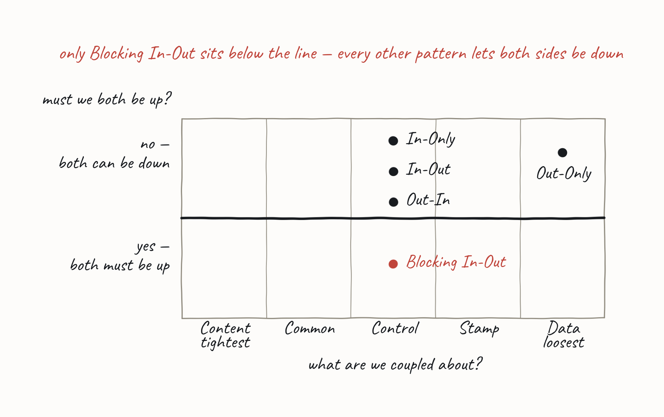
ACROSS ALL FOUR PATTERNS
Choosing an Exchange Pattern
99
Notes:
Third appearance of the grid — §2 introduced it, §3 plotted the integration styles on it, and now the exchange patterns land on it too. The repetition is deliberate: it is the one picture that carries the argument of the day, and delegates should be able to draw it from memory by the end.

Slide 100
PRACTICAL MESSAGING — DAY ONE
6.1 Fat and Skinny Messages
Normalising the message: inline it, reference it, or replicate it.
100

Slide 101
6.1 FAT AND SKINNY MESSAGES
What Goes in a Message?
The decision is per field, not per message. For every piece of data the provider needs in order to act, there are three choices:
Inline it — put the value in the message.
•
Reference it — put an id in the message; the provider looks the data up.
•
Replicate it — the provider already holds a copy, kept fresh out-of-band.
•
Designing a message is a normalisation problem.
A fat message is fully denormalised. A skinny message is fully normalised. Neither extreme is usually right.
•
The rest of this section is the rule that decides per field, and the price of each answer.
•
101
Notes:
Delegates already have this mental model from database design — they have just never applied it to messages. Normalise by default; denormalise deliberately for the lookups that hurt; and own the staleness you have created. That is the whole section in three sentences.

Slide 102
6.1 FAT AND SKINNY MESSAGES
Fat Message
With a Fat Message, the requestor sends across all the external information a provider may need to perform the operation.
The requestor provides all external information the provider needs to act.
•
The resulting document message may be large (a Claim Check can help).
•
Example. Order Fulfilment → Courier Assignment: the request provides delivery and pickup address, size, weights, etc. of the order.
•
What it buys you: the provider needs nobody else in order to act. No lookup, no cache, no second system that has to be up.
102

Slide 103
6.1 FAT AND SKINNY MESSAGES
Fat Message — Transitive Dependencies
A purchase-order message that inlines customer and restaurant data shows the cost.
The order data has the lifetime of the message — its schema changes if the purchase order changes. That is fine; it is our data.
•
Customer data is a transitive dependency — its lifetime is the Customer's. A Customer schema change may force a message change.
•
Restaurant data is likewise a transitive dependency on the Restaurant schema.
•
103
Notes:
This is the slide that motivates the rule two slides later. The message did not just get bigger — it acquired two more reasons to change, and both are owned by other teams. Walk the picture by owner, not by field. Count the fields aloud — three ours, three the Customer's, two the Restaurant's — and then ask who has to be consulted before the message's schema can change. The answer is three teams, for one message.

Slide 104
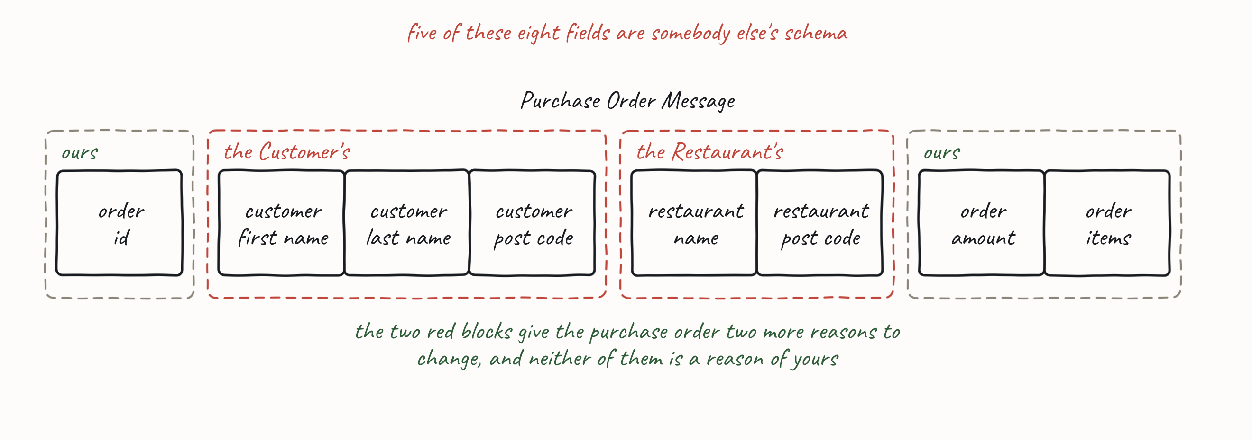
6.1 FAT AND SKINNY MESSAGES
Fat Message — Transitive Dependencies
Inline someone else's data and you have inherited their release schedule.
104
Notes:
This is the slide that motivates the rule two slides later. The message did not just get bigger — it acquired two more reasons to change, and both are owned by other teams. Walk the picture by owner, not by field. Count the fields aloud — three ours, three the Customer's, two the Restaurant's — and then ask who has to be consulted before the message's schema can change. The answer is three teams, for one message.

Slide 105
6.1 FAT AND SKINNY MESSAGES
Skinny Message
With a Skinny Message, the requestor provides only information unique to the event, and assumes the provider has, or can obtain, the other information.
The resulting notification message is normally skinny.
•
Example. Order Notification → Courier Assignment: notifies that there is an order, inlining only order-unique data — not reference data like weights or addresses. Courier Assignment must source the missing information from elsewhere.
•
What it costs you: the provider can no longer act alone. Something else has to supply the rest — which is the next sub-topic.
105

Slide 106
6.1 FAT AND SKINNY MESSAGES
The Lifetime Rule
If the data does not share the message's lifetime, put an id in the message, not the data.
The purchase-order message carries CustomerId and RestaurantId instead of inlined data.
Data that shares the message's lifetime → inline it.
•
Data with its own lifetime → reference it by id; assume the requestor obtains the data out-of-band.
•
These ids must be looked up with other providers (Customer, Restaurant).
•
Then be pragmatic. Exactly as with a database, you may denormalise — inline a common lookup so you do not pay for it on every message.
Do it for the lookups that actually hurt, not by default.
•
The moment you copy someone else's data into your message you own a stale copy, and you have taken on their schema.
•
The rule is the default; a denormalisation is a decision you should be able to justify.
•
106
Notes:
Just like a Db, we allow optimisation by inlining some common lookups — so "it depends", and be pragmatic, on top of the rule. The rule stops the choice being arbitrary; the pragmatism stops it being dogma. Ask which lookups in their own systems would justify it.

Slide 107
PRACTICAL MESSAGING — DAY ONE
6.2 Reference Data
How the provider gets what the message did not carry.
107

Slide 108
6.2 REFERENCE DATA
Reference Data
The requestor assumes Provider A has a local cache of data from Provider B that it can use to look up the identifiers in a skinny message.
Data that leaves Provider B via an API is Reference Data: immutable, versioned, stale.
•
Immutable and versioned because a copy that can change shape under its holder cannot be cached safely.
•
It can be cached locally to Provider A to avoid frequent lookups (cache lookup()).
•
108

Slide 109
6.2 REFERENCE DATA
Get It On Demand — REST/RPC
On a cache miss, Provider A fetches the data from Provider B synchronously.
Look up missing data in the local reference-data cache (may specify identity and version).
•
On a miss, request from Provider B and store it in the cache (request() / reply() / cache write()).
•
What it costs you
On a hit: availability over consistency — you serve possibly-stale data and stay up.
•
On a miss: consistency over availability — and A's uptime becomes the uptime of A and B. If B fails, A fails.
•
109
Notes:
This is the Day 1 argument arriving inside message design. The lookup is a synchronous call in the middle of a message flow, so availabilities multiply again — and only on the unlucky path, which is exactly what makes it hard to catch in testing.

Slide 110
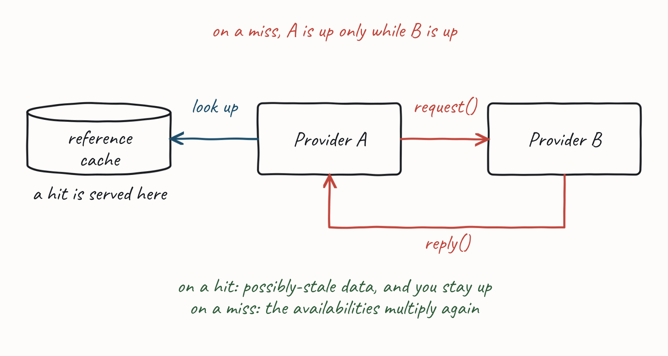
6.2 REFERENCE DATA
Get It On Demand — REST/RPC
A cache miss is a temporal coupling you did not plan for.
110
Notes:
This is the Day 1 argument arriving inside message design. The lookup is a synchronous call in the middle of a message flow, so availabilities multiply again — and only on the unlucky path, which is exactly what makes it hard to catch in testing.

Slide 111
6.2 REFERENCE DATA
Content Enricher — Someone Else Does the Lookup
A Content Enricher is a filter step that adds required data the publisher did not include: it listens on the channel, fetches what is missing, and republishes the message complete.
A new order carries an AccountId, but shipping needs the customer's address. The enricher adds the address, and the shipping consumer then has what it needs.
•
Especially common in microservices, where each service holds only its own data and something has to do the join.
•
111
Notes:
Same argument as Get It On Demand, with the lookup moved one hop. Make the callout the point: teams reach for an enricher believing it decouples them, when all it has done is put a third party in the chain — A now depends on the enricher and B. Same arithmetic, one hop further away, and now it fails somewhere nobody owns.

Slide 112
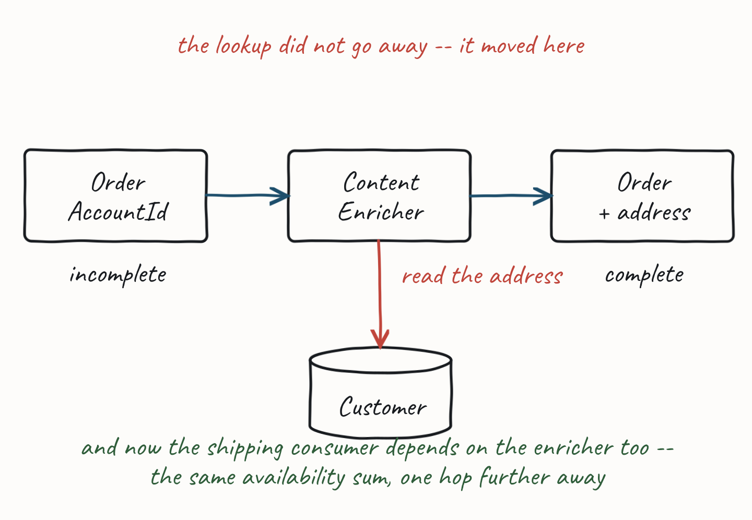
6.2 REFERENCE DATA
Content Enricher — Someone Else Does the Lookup
The enricher does not remove the lookup. It moves it — and the availability sum moves with it.
112
Notes:
Same argument as Get It On Demand, with the lookup moved one hop. Make the callout the point: teams reach for an enricher believing it decouples them, when all it has done is put a third party in the chain — A now depends on the enricher and B. Same arithmetic, one hop further away, and now it fails somewhere nobody owns.

Slide 113
6.2 REFERENCE DATA
Get It In Advance — ECST (Event-Carried State Transfer)
Provider B publishes its state changes; Provider A subscribes and keeps a local copy. A never makes a synchronous call to read it.
The upstream provider raises a notification when its own entity state changes (Out-Only / pub-sub).
•
The downstream provider subscribes and writes to its local cache (cache write()); every request then reads locally.
•
There is no miss path, so there is no synchronous call in the middle of a message flow.
•
113
Notes:
Teach this as the recommendation, not a warning. Land the mechanism first and let the room notice what is missing from it: there is no miss path at all, so there is no synchronous call anywhere in the flow. The two slides that follow are the why and the cost — do not pre-empt them here.

Slide 114
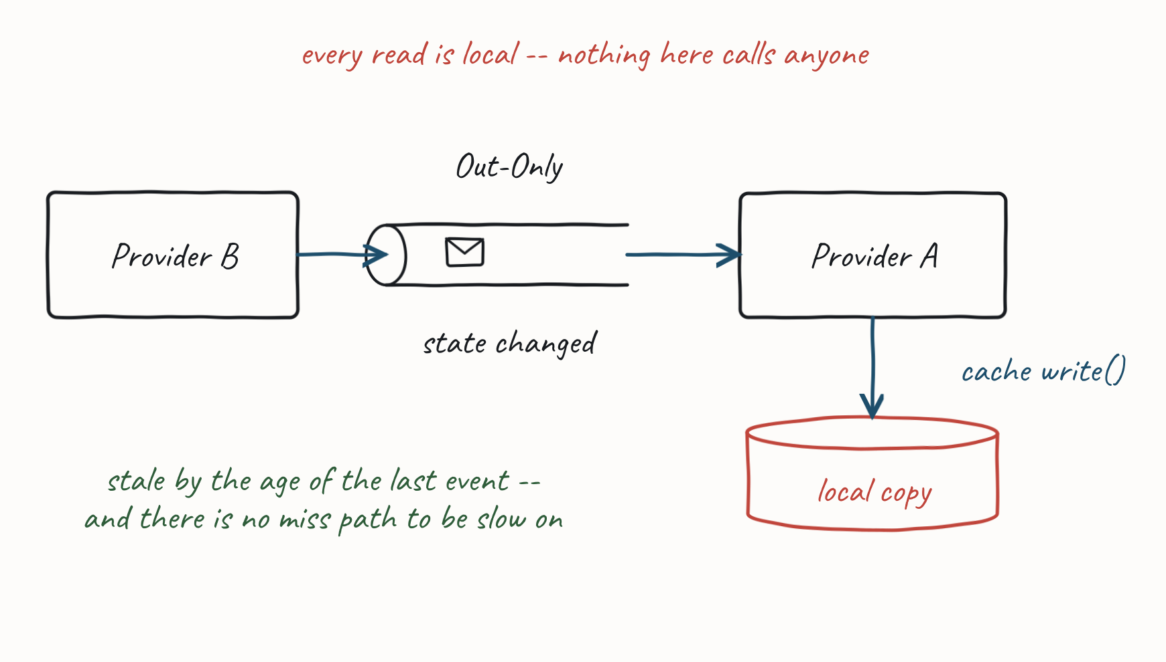
6.2 REFERENCE DATA
Get It In Advance — ECST (Event-Carried State Transfer)
This is the default. Prefer it to the synchronous lookup.
114
Notes:
Teach this as the recommendation, not a warning. Land the mechanism first and let the room notice what is missing from it: there is no miss path at all, so there is no synchronous call anywhere in the flow. The two slides that follow are the why and the cost — do not pre-empt them here.

Slide 115
6.2 REFERENCE DATA
Why It Holds Up in Practice
Latency is not the problem people expect it to be. Propagation is a broker hop — you are behind by milliseconds to seconds. And this is reference data: restaurants, customers, price lists. It changes rarely, and rarely in a way the next message depends on.
•
Versioning is what makes it safe. Carry id and version. Then "I have not seen this yet" is distinguishable from "I have it", and a missing version becomes a wait rather than a wrong answer — which the worked example shows.
•
You removed the temporal coupling rather than relocating it. A stays up when B is down. Day 1 §Coupling's Must We Both Be Up? arriving inside message design.
•
115
Notes:
In practice ECST is reliable, latency rarely causes an actual problem, and versioning the reference data closes the gap that remains. Do not hedge it with "replicas go stale, go wrong, and need rebuilding" — that over-states the risk. Reference data is the case where the numbers are on our side, and each bullet is one of the three reasons why.

Slide 116
6.2 REFERENCE DATA
Be Honest About the Trade — and Which Way It Runs
ECST chooses availability over consistency on purpose, and by an amount you can measure: you read a copy that is behind by the propagation delay. The synchronous lookup is not the consistent option — it makes the same trade on a cache hit, and then reverses it on a miss, when B is down and you are not.
What it actually costs: you are running a replica, so you own a subscription and you must be able to rebuild it — replay the stream from the beginning. That is operational work, not a correctness risk.
When to still reach for the lookup: the data genuinely cannot be replicated — too large, too sensitive, or it must be fresh at the instant you read it (an authorisation or a balance check). Then take the coupling knowingly, and put a circuit breaker on it.
116
Notes:
The sharpest line in the room is the one about which way the trade runs — delegates arrive believing the synchronous lookup is the "correct" option and the cache is the shortcut, and it is the other way round. Ask what their p99 is on a cache miss when the upstream is degraded; nobody knows, which is the point.

Slide 117
6.2 REFERENCE DATA
Reference Data — Worked Example
Order Fulfilment → Courier Assignment: the request omits the restaurant pickup address; we assume Courier Assignment obtained it from Restaurant Information.
Look up the restaurant in the local cache by id and version.
•
If we have the restaurant but not that version, apply backpressure and retry the order after a delay.
•
A missing version is a wait. A missing value would have been a wrong answer.
117
Notes:
This slide is the proof of the previous one's claim — it is what "particularly if you version the reference data" actually looks like. Without the version you cannot tell "I have not seen this yet" from "I have it", so staleness is invisible and you have to guess; with it, the replica knows what it does not know. Backpressure here is the same idea they meet again on Day 2 in the reactive material.

Slide 118
PRACTICAL MESSAGING — DAY ONE
6.3 Event Shape
What shape of event lets the receiver keep a copy — and what guarantees that buys.
118

Slide 119
6.3 EVENT SHAPE
Domain or Delta Event
An approach to Pub-Sub where the provider communicates granular state changes to its requestors.
Messages are usually named as a past participle after the causing command (e.g. BasketItemRemoved, BasketItemAdded).
•
Cannot use a Datatype Channel — domain events for the observable must be ordered on the same channel and have different schemas. This burdens the requestor to multiplex handling of the events.
•
119

Slide 120
6.3 EVENT SHAPE
Summary or Snapshot Event
An approach to Pub-Sub where the provider communicates a summary of state changes.
The message is versioned and contains metadata describing the cause(s) of changes; usually named after the observable (e.g. BasketChanged).
•
Can use a Datatype Channel — there is just one schema for a snapshot of the observable.
•
120

Slide 121
6.3 EVENT SHAPE
Why ECST Needs Snapshots
You cannot replicate someone else's state from deltas unless you receive every one of them, in order.
With Domain/Delta events, a missed or reordered message leaves the replica permanently wrong — and nothing in the stream tells you. You must apply them all, you can only use blocking retry, and you cannot shed load.
•
With Summary/Snapshot events, each message is complete in itself. A missed one is repaired by the next one to arrive.
•
Choose the delta and you have chosen strict ordering. Choose the snapshot and you have bought it back.
121
Notes:
This is the join between the two halves of the section. ECST works because of the snapshot event — it is what makes If Later, Stream and If Later, Queue possible at all, and it is the reason the previous sub-topic could recommend ECST without hedging. The rule: publish complete new versions rather than deltas.

Slide 122
6.3 EVENT SHAPE
If Later, Stream
If Later lets us use a versioned Summary Event to ignore ordering errors.
Consumer reads v1 of 12345 and handles it; reads v3 and applies it (later than v1); reads v2 and discards it (earlier than the already-applied v3).
•
Even on a stream, non-blocking retry or guaranteed delivery via an outbox can produce out-of-order messages; If-Later also lets us shed load.
•
We cannot use If-Later with a Domain Event — those must all be applied. With Domain Events we can only use a blocking retry and cannot shed load.
•
122
Notes:
Publish complete new versions rather than deltas, then apply "write if later" — with v0, we can write v2 even without seeing v1, because v2 is later and either overwrites or includes v1's changes; we can then safely discard v1.

Slide 123
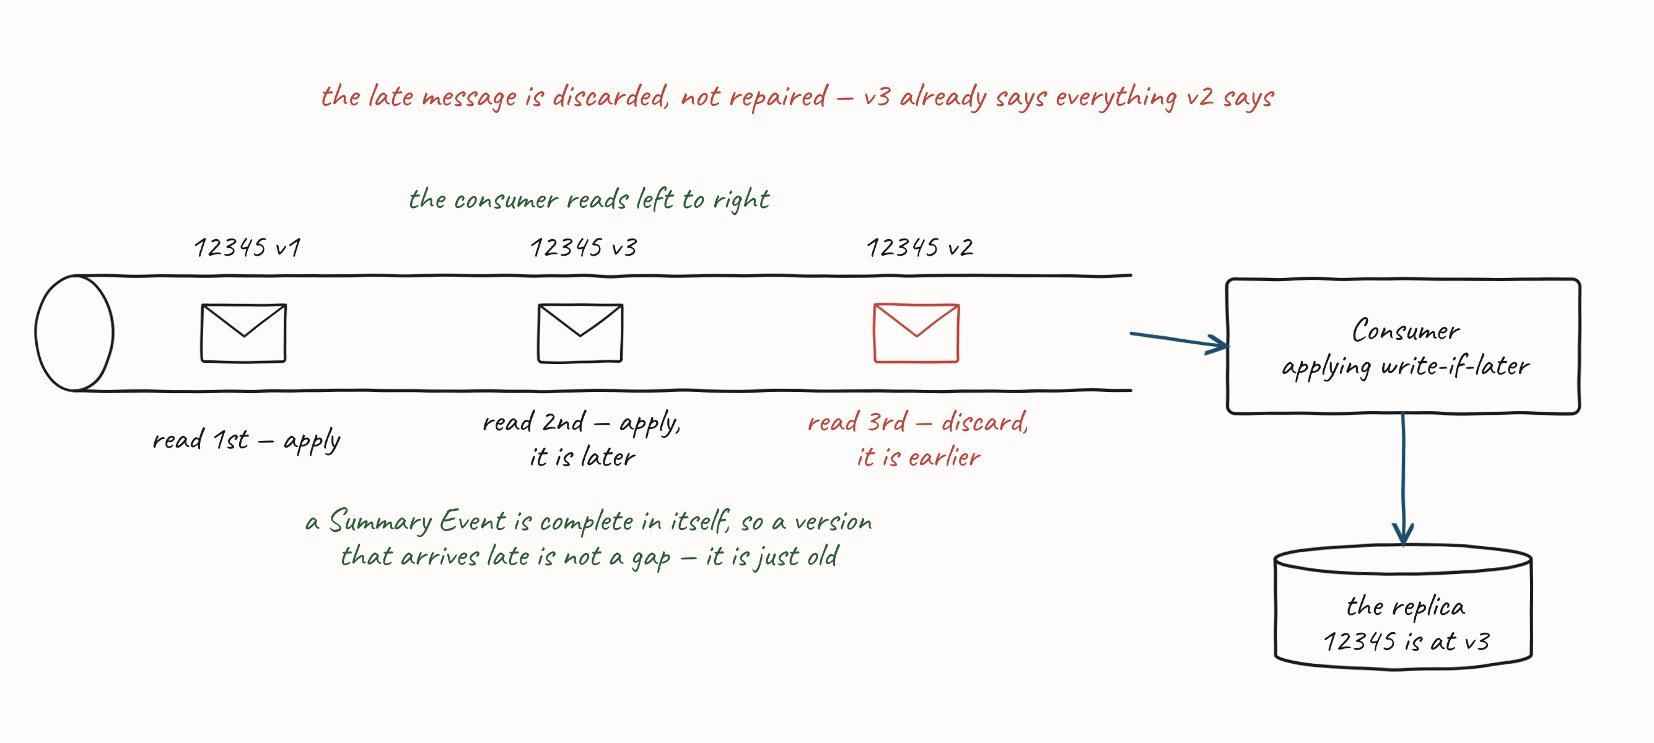
6.3 EVENT SHAPE
If Later, Stream
123
Notes:
Publish complete new versions rather than deltas, then apply "write if later" — with v0, we can write v2 even without seeing v1, because v2 is later and either overwrites or includes v1's changes; we can then safely discard v1.

Slide 124
6.3 EVENT SHAPE
If Later, Queue
If-Later also lets messages be processed out-of-order with a queue and competing consumers.
One consumer expects/writes v1 while another writes v2; read-past lets them proceed.
•
A queue normally processes messages (not events), so this applies only where we use a queue.
•
If a message must be ordered (e.g. a series of commands), use requeue-with-delay or a sequencer to re-order.
•
124

Slide 125
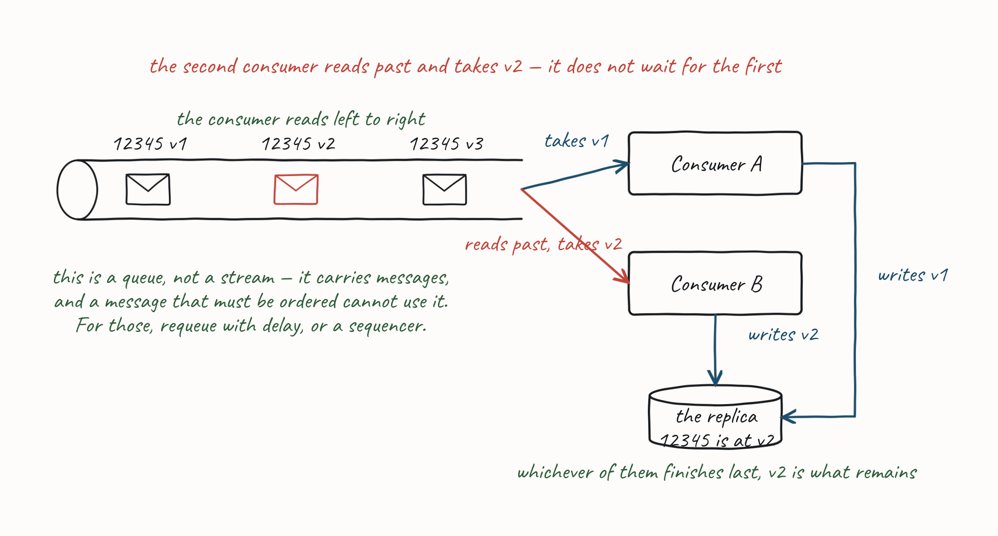
6.3 EVENT SHAPE
If Later, Queue
125

Slide 126
6.3 EVENT SHAPE
Public and Private Providers
An approach to Pub-Sub where a public provider communicates with collaborators in other domains via a Summary Event aggregated from the domain events of private providers.
Private providers raise granular event()s.
•
The public provider republishes a versioned summary() with metadata describing the cause(s) of changes.
•
126
Notes:
This is how both event shapes coexist — deltas inside a domain, where ordering is cheap and the consumers are yours; snapshots across the boundary, where neither is true. It is the same public/private split as an Open Host Service.

Slide 127
PRACTICAL MESSAGING — DAY ONE
Closing
Where to go deeper, and what to ask.
127

Slide 128
CLOSING
Further Reading — Data on the Outside
Data on the Outside versus Data on the Inside — Pat Helland, CIDR 2005. Free online.
The paper behind this morning: data that crosses a process boundary is a copy, immutable and already stale, and that is why it travels as a message rather than a call.
128
Notes:
The four readings walk the day in the order it was taught — the boundary, then coupling and the styles, then the pattern catalogue, then queues and streams. Say that, because it turns a bibliography into a map of what they just did. This one is the cheapest to act on: it is a paper, it is free, and it is the argument §The Process Boundary makes without naming its source.

Slide 129
CLOSING
Further Reading — Building Microservices
Building Microservices — Sam Newman (O'Reilly, 2nd edition). samnewman.io
For §Coupling and §Integration Styles — the same four styles on the same grid, argued at book length, and the boundary as an organisational one as much as a technical one.
129

Slide 130

CLOSING
Further Reading — Enterprise Integration Patterns
Enterprise Integration Patterns — Gregor Hohpe & Bobby Woolf. enterpriseintegrationpatterns.com
The catalogue §Messaging Patterns follows. Every pattern named today is written up there in full, with the trade-offs the slides had to compress.
130

Slide 131
CLOSING
Further Reading — Designing Data-Intensive Applications
Designing Data-Intensive Applications — Martin Kleppmann (O'Reilly). dataintensive.net
For §4.5 Queues and Streams and §6.3 Event Shape — ordering, idempotency, replication, and why a log and a queue are not the same thing.
131

Slide 132
CLOSING
Q&A
Questions and discussion.
132

